Slide 1
Efficient Filters for Geometric Intersection Computations using GPU
Yiming Liu
PhD Advisor: Dr. Satish Puri
Department of Computer Science
Marquette University
Contact: yiming.liu@marquette.edu , satish.puri@marquette.edu

Slide 2
Overview
Application: Geographic Information System (GIS)
Spatial Database
New Ideas: A two-step geospatial filter PSCMBR
Parallel PolySketch-based PNP filters
Use a collection of filters on GPU
Experimental results

Slide 3
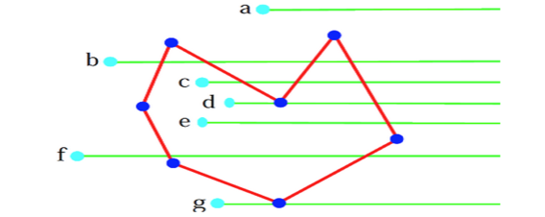
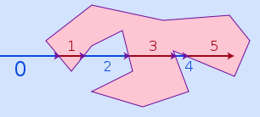
Basics: Intersection and Point-in-Polygon
Hotspots => PNP

Slide 4
Polygon Intersection
Black points are line segment intersection points
(b) Blue and Red points are the vertices inside another polygon
(c) Output polygon

Slide 6
Filter and Refine
A
A Rectangle
Filter
Overlap
Refine
Approximate
Output:
B
B Rectangle
Discard (A,B)

Slide 7
Common Minimum Bounding Rectangle
Red rectangle is CMBR
Large CMBR is a problem

Slide 8
PolySketch: Hierarchy of tiling
Sketch of polygon or polyline
Recursive tiling of boundary
Tile size: how many line segments inside one tile
Figure: PolySketch with three different tile sizes.

Slide 9
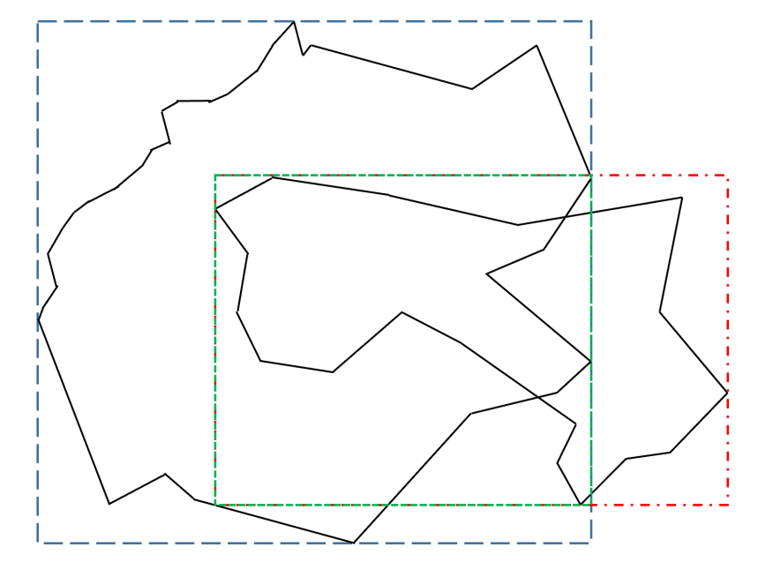
CMBR and PolySketch

Slide 10
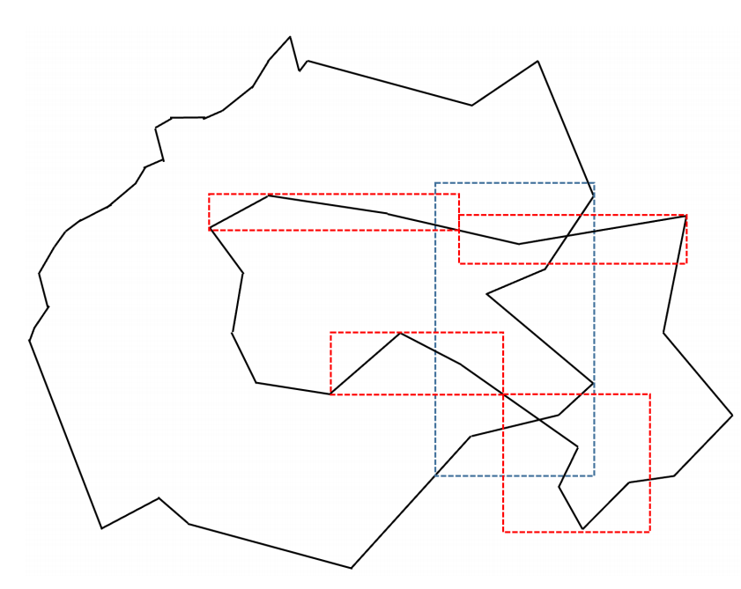
CMBR and PolySketch

Slide 11
PolySketch-based CMBR Filter (PSCMBR)

Slide 12
PolySketch-based CMBR Filter (PSCMBR)

Slide 13
GPU vs CPU
GPU is suited to handle compute-intensive work.
GPU emphasizes on high throughput instead of low latency compared to CPU.
Compared to CPU that includes a few cores with a lot of cache memory, GPU contains hundreds or thousands of cores that can deal with great number of threads simultaneously.
The complex problems should be divided into a lot of separate tasks on GPU.

Slide 14
Challenges of using GPU
Reading and writing data in global memory are expensive
Extra cost of copying data between GPU and CPU
limited GPU memory
Programming on GPU is very different because the structure is different from CPU. For example, complicated code with lots of if-else branches and irregular program are harder to be parallelized.

Slide 16
PNP Filters
Motivation:
1. Fast geometric intersection is impossible without efficient PNP test.
2. The tiles and intersection points information for every task after LSI function is useful
There are two ways to make PNP filters work:
(1) Reducing the number of vertices to be tested
(2) Reducing the number of line segments to be compared against.

Slide 17
PolySketch-based PNP Filter
PolySketch-based PNP filter divides the tiles into two types: intersection tile and no-intersection tile.
Intersection tile: a tile has at least one line segment intersection. (We can do PNP test only for a few vertices within this tile and then we know all vertices within this tile are inside another polygon or not.)
No-intersection tile: a tile does not have any line segment intersection. (We should test all vertices within the tile because there are line segment intersections and any vertex within this tile can be inside another polygon or not.)

Slide 18
PolySketch-based PNP Filter
Two polygons: A1 (black) from layer1 and B1 (blue) from layer 2.
The tile-size is set as 5 line segments.
Five tile-MBR overlap pairs in total.
Intersection tiles: red rectangles.
No-intersection tiles: yellow rectangles.

Slide 19
PNP test: Checking whether a point is inside another polygon based on how many times an imaginary ray from the test point crosses the polygon boundary.
Tile-based PNP filter: To discard the line segments which the ray could not cross, we compare the test point only with the line segments within the tiles whose MBRs overlap with the y-coordinate of the test vertex.

Slide 20
Workload Reduction
Task two polygons P and Q from each layer.
P has m and Q has n line segments.
Workload = m∗n for each task.
Total workload = summation of workload for each task
Reduction due to filter

Slide 21
Data sets

Slide 22
PSCMBR & PolySketch & CMBR effect on the LSI function for Water Dataset

Slide 23
Performance using different tile-size for Water Dataset
We can either use the same tile-size for both polygons
or
Use different tile-size based on the size of the polygon.

Slide 24
Performance using PolySketch-based PNP filter

Slide 25
Performance using PNP filters

Slide 26
Performance of New System

Slide 27
Related Work
The paper [1] introduces a system HiFiRe which is able to process polygon intersection over large polygonal datasets by using GPU.
The paper [2] introduces a system GCMF which is able to efficiently handle spatial join over large polygonal datasets by using GPU.

Slide 28
Reference
[1]. Liu, Yiming, Jie Yang, and Satish Puri. "Hierarchical Filter and Refinement System Over Large Polygonal Datasets on CPU-GPU." In 2019 IEEE 26th International Conference on High Performance Computing, Data, and Analytics (HiPC), pp. 141-151. IEEE, 2019.
[2] Aghajarian, Danial, Satish Puri, and Sushil Prasad. "GCMF: an efficient end-to-end spatial join system over large polygonal datasets on GPGPU platform." In Proceedings of the 24th ACM SIGSPATIAL International Conference on Advances in Geographic Information Systems, p. 18. ACM, 2016.

Slide 29
Thank you!

