Slide 1
Hierarchical Filter and Reﬁnement System over Large Polygonal Datasets on CPU-GPU
Satish Puri (Presenter)
Yiming Liu and Jie Yang
Marquette University
Milwaukee, Wisconsin, USA

Slide 2
Overview
Application: Geographic Information System (GIS)
Spatial Database
New Ideas: Sketch of geometry by tiling
Filter based on PolySketch
Use a collection of filters (not just one)
Experimental results

Slide 3
Polygon Intersection
(a) Black points are line segment intersection points (LSI)
(b) Blue and Red points are the vertices inside another polygon
(c) Output polygon

Slide 4
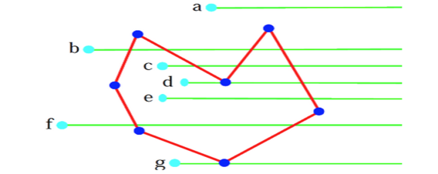
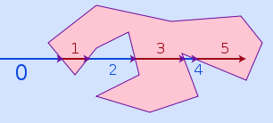
Basics: Intersection and PNP

Slide 5
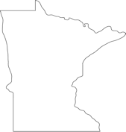
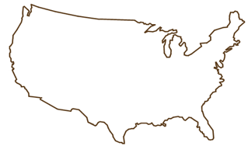
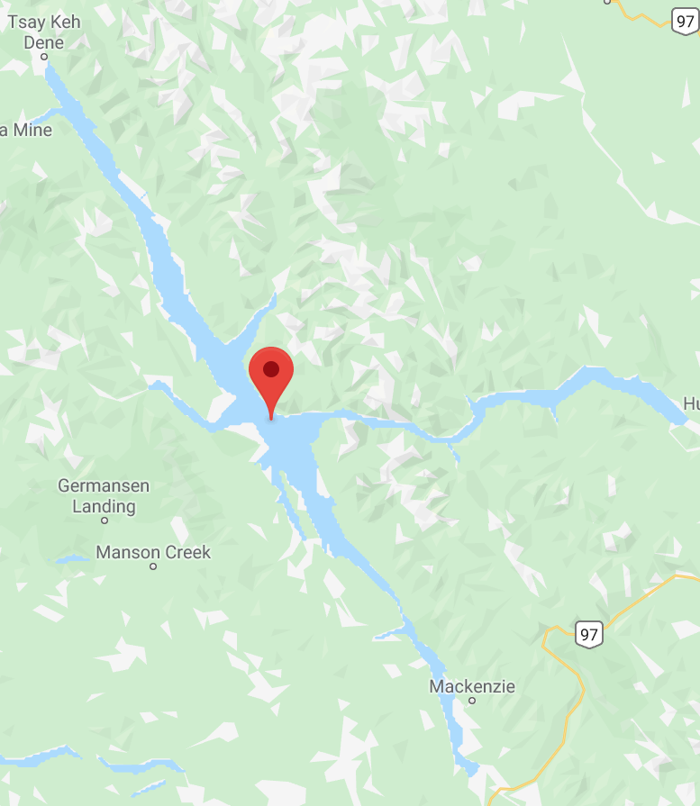
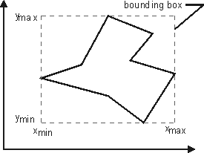
Geometry and its bounding rectangle
MBR = Rectangle
4 points in 2D
Polygon(20 30, 25 40, .., )
Lake with more than 100K pts
Notes:
Large polygon: Williston Lake in Canada.
over a million vertices and 10 MB in size.

Slide 8
Accelerating Pathology Image Data Cross-Comparison on CPU-GPU Hybrid Systems. PVLDB

Slide 9
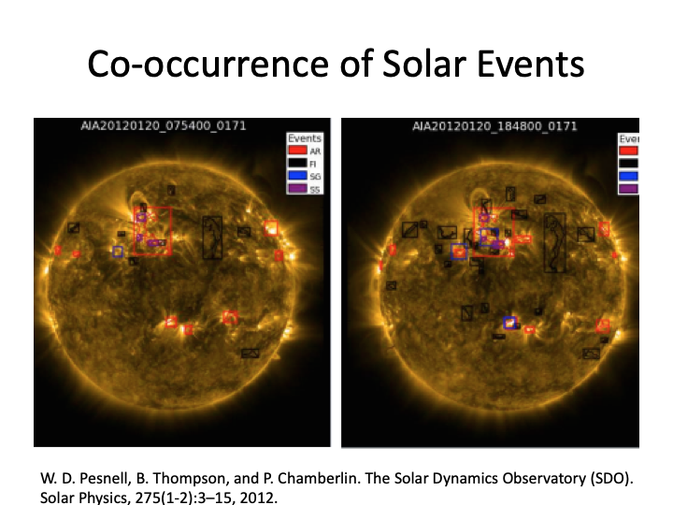
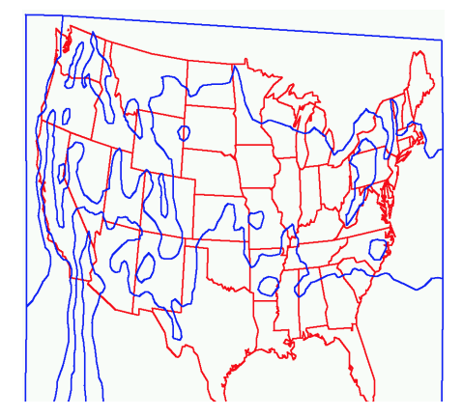
Spatial computation in Weather domain
MINIMAL REPRESENTATIONS OF POLYGONS AND POLYHEDRA
Notes:
isotherm are blue lines

Slide 11
Common Minimum Bounding Rectangle
Red rectangle is CMBR [2].
Large CMBR is a problem.

Slide 12
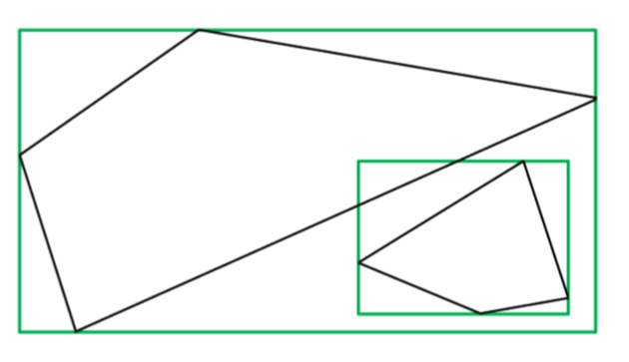
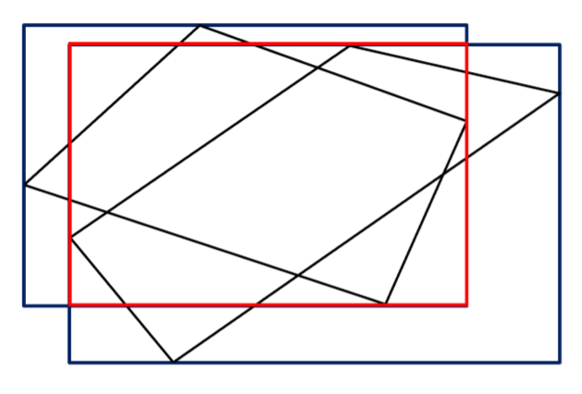
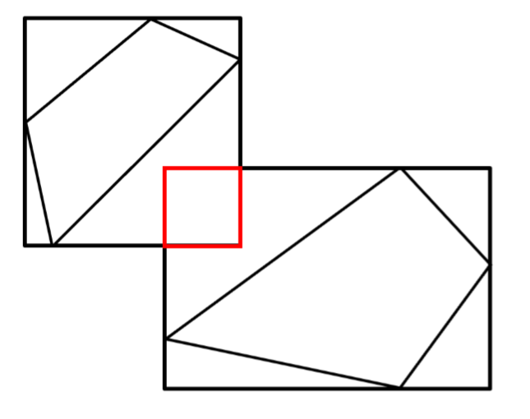
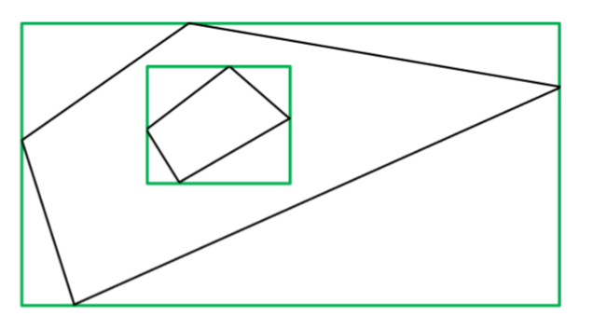
Filter and Refine phases
Go to
Refine
Go to
Refine
Go to
Refine
Ignore
Filtered Out
Go to
Refine

Slide 13
PolySketch: Hierarchy of tiling
Sketch of polygon or polyline
Recursive tiling of boundary only.
Space-Time tradeoff
Figure: PolySketch with three different tile sizes.

Slide 14
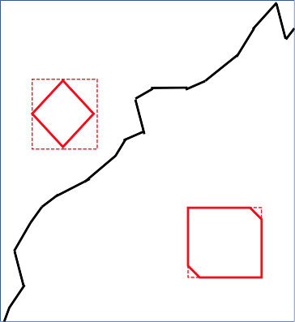
Rectangle overlap
A = River (black)
B = Kite (red)
C = Square (red)
Observation
A.rectangle overlaps
with B and C rectangle

Slide 15
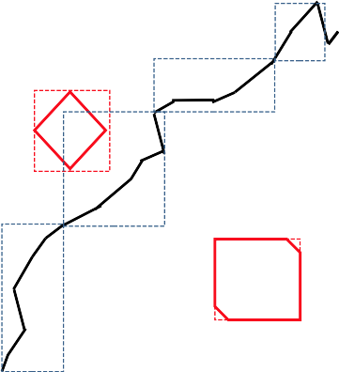
River.MBR overlaps with Kite.MBR
River (black)
Kite (red)

Slide 16
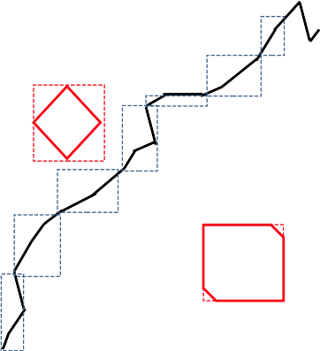
No rectangle overlaps
Increases Filter Efficiency

Slide 17
Polygon intersection using PolySketch
PolySketch size is set as 5 line segments.
P1 has five tiles.
Q1 has five tiles.

Slide 18
Polygon intersection using PolySketch
Filter
There are four tile overlap pairs.

Slide 19
Motivation
Balancing Filter and Refine workloads
Filter Refine | Hierarchical Filter and Refine
Filter = 1 sec Refine = 10 sec Total time = 11 sec | Filter 1 = 1 sec Filter 2 = 2 sec Refine = 3 sec Total time = 6 sec
Suitable to CPU Efficient O(n log n) algo. | Suitable to GPU Robust Plane sweep implementation not available

Slide 20
A hierarchy of Filters
R-Tree Filter (like B-Tree but for rectangles)
Common Rectangle Filter
PolySketch Filter
Point-in-Polygon Filter

Slide 21
Compiler directives for implementation
CPU - OpenMP
GPU - OpenACC (PGI Compiler)
Faster learning and development time compared to CUDA
Code easier to maintain
Previous work in this area is CUDA based.

Slide 23
Block diagram of algorithm

Slide 24
Different cases:
(a) Two polygons have line segment intersections
(b), (c) Two polygons touch each other
(d) Two polygons’ MBRs overlap but there is no actual intersection points
(e) One polygon is inside another polygon but there is no line segment intersection
(f) The smaller polygon is not inside another polygon but the smaller MBR is inside another MBR

Slide 25
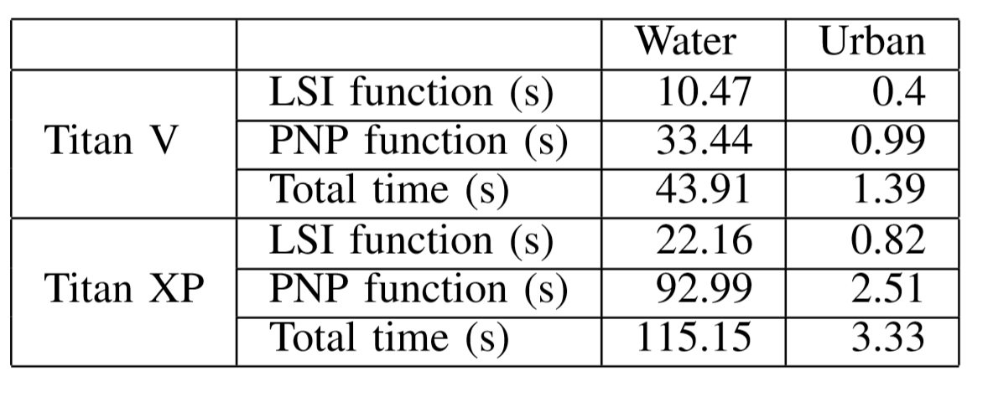
Data sets
Running time without filters

Slide 26
Workload Reduction
Task two polygons P and Q from each layer.
P has m and Q has n line segments.
Workload = m∗n for each task.
Total workload = summation of workload for each task
Reduction due to filter

Slide 27
The workload in LSI after using
CMBR and PolySketch Filter

Slide 28
PolySketch & CMBR effect on the LSI function for
Water Dataset

Slide 29
Performance using different tile-size for Water Dataset
We can either use the same tile-size for both polygons
or
Use different tile-size based on the size of the polygon.
Tuning is required to get the best performance

Slide 30
Execution time breakdown details for Water Dataset

Slide 31
Related Work
The paper [1] proposes a method to perform polygon overlay with OpenMP on CPUs and CUDA on GPUs and shows the benefit.
The paper [2] introduces a system GCMF which is able to efficiently handle spatial join over large polygonal datasets by using GPU.
The paper [3] presents and demonstrates an effective parallelization of plane sweep on GPUs.

Slide 32
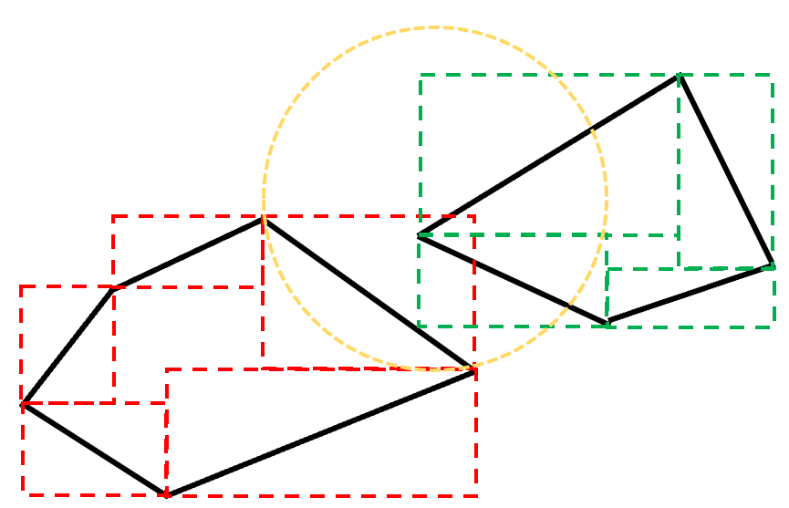
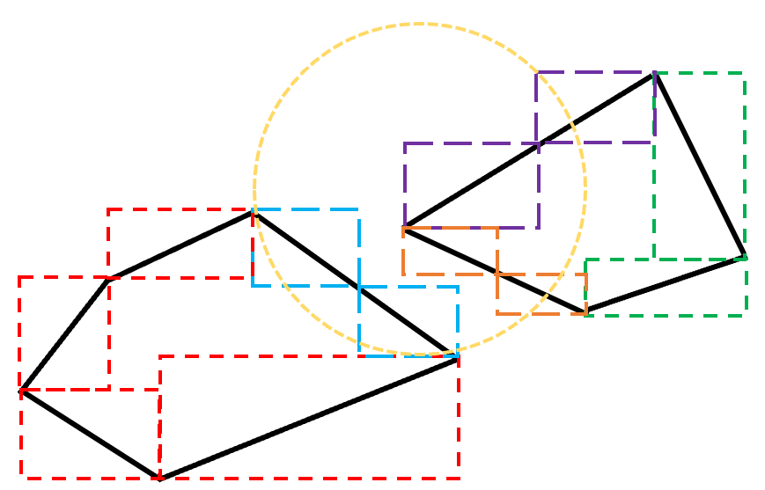
Future Work
Integrate the system to MPI-GIS and MapReduce implementations
Improve PNP test and its pre-process phase
Adaptive tile-size

Slide 33
Reference
[1] Aghajarian, Danial, Satish Puri, and Sushil Prasad. "GCMF: an efficient end-to-end spatial join system over large polygonal datasets on GPGPU platform." In Proceedings of the 24th ACM SIGSPATIAL International Conference on Advances in Geographic Information Systems, p. 18. ACM, 2016.
[2] Audet, Samuel, Cecilia Albertsson, Masana Murase, and Akihiro Asahara. "Robust and efficient polygon overlay on parallel stream processors." In Proceedings of the 21st ACM SIGSPATIAL International Conference on Advances in Geographic Information Systems, pp. 304-313. ACM, 2013.
[3] Paudel, Anmol, and Satish Puri. "OpenACC Based GPU Parallelization of Plane Sweep Algorithm for Geometric Intersection." In International Workshop on Accelerator Programming Using Directives, pp. 114-135. Springer, Cham, 2018.

Slide 34
Thank You!

