Slide 1


Side-channel Attacks and Mitigation Methods
for
Trusted Execution Environments
A K M Mubashwir Alam, Keke Chen

Slide 2







Computing with Untrusted Platforms
Use cases:
Users’ private data are delegated to untrusted (public) cloud servers
Multi-sources (federated) deep learning
Machine-Learning As A Service
Data sharing of genomic data or big data
Security concerns
Compromise
Security?
Program
Data
+
User
Result
Tamper program
Tamper data
Steal sensitive information
Server
Goal
Confidentiality: Other platforms learns nothing
Integrity: Server returns accurate result
Efficiency: Faster execution time

Slide 3
Most well-known approaches so far
Software-based crypto approaches
  Fully Homomorphic Encryption (FHE)
  Secure Multi-party Computation (SMC)
Hardware Isolation Technique
  Trusted Execution Environment (TEE)

Slide 4


Most well-known approaches so far
Type | Approach | Performance | Communication Cost | Confidentiality | Integrity | Easiness of Development
Software based Approaches | FHE | Slow | High
 | SMC | Slow | High
 | SE | Slow | High
 | ZK | Slow | High
Hardware based Approach | TEE | Efficient | Low

Slide 5



Trusted Execution Environment
Hardware based software isolation technique
A secure area of the main processor
Aims to protect the code and data in the secure area
Major TEEs:
*AMD Adopted TrustZone

Slide 6






Intel SGX as Trusted Execution Environment
Major features:
Remote apps gain ability to defend its secret
App built with trusted and untrusted parts
App launches in Enclave processed in protected memory
Enclave runs with signed binary
Enclave functions execute with plain text data
Enclave supports multi-threading (limited)
Application
Untrusted Part
Trusted Enclave
create_enclave( )
</>
ECALL
Encrypted
Data
Plain Data
OCALL
Restricted by CPU
Privileged System Code
OS, VMM, BIOS
Secured Channel
Secured Channel
Attestation Server
Achieve Trust via Remote Attestation
Notes:
Extension of x86 Instruction set

Slide 7
Is Intel SGX flawless?
Limitations of SGX
  Functional Limitation
  Side Channel Attacks

Slide 8
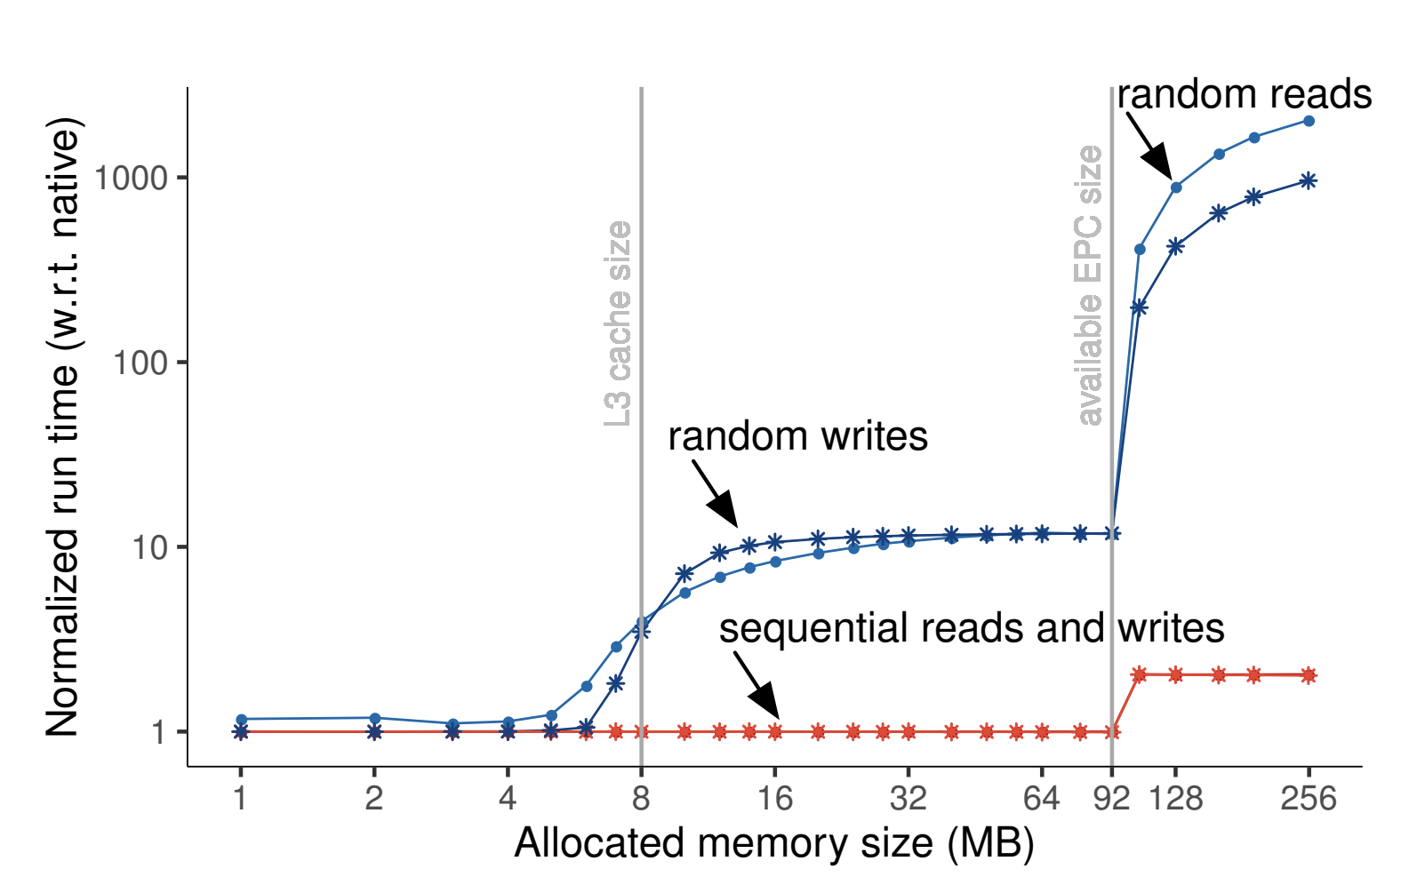
Functional Restrictions of SGX
Memory
Restricted functions
  IO Access/ Network Access/ all system calls
Language limitations: Only supports C++
Private Reserved Memory (PRM) limited ~128 MB (sgx v1) [1]
  Paging enables more memory
  Incurs expensive enclave page swapping
  Slowdown execution
Recent updates on SGX memory
  SGX v2 allow 256 MB physical memory
  SGX v3 will allow 1TB physical memory (Plan)
Non PRM
Up to TBs
PRM
128 MB
From Sergei et al. [2]:
Paging Incurs significant cost overhead
for random data access
[1] Intel SGX Explained, Costan et al, 2016
[2] SCONE: Secure Linux Containers with Intel SGX, Sergei et al., Usenix’16

Slide 9

Threat Model for Side-channel Attacks
Adversary can compromise the running system ( OS/hypervisors )
- Observe
  all of the data that remains outside the SGX enclaves
  program executions
  and memory management
- Tamper the application data and program running in the untrusted memory
- Manipulating OS modules
  Force page faults within enclave
  Obtain in-enclave memory access patterns
- Can exploit the execution mechanism of CPU’s micro-architecture from OS
Out of Scope
Denial-of-service Attack
Side-channel attacks based on power analysis
Notes:
Adversary can thus analyze and detect interaction patterns between SGX enclave process and the untrusted memory.

Slide 10
Side Channel Attacks
We have done a thorough study and classify the side channel attacks based on attack strategies:

Slide 11
Side Channel Attacks (Cont.)
Side Channel Attacks:
Memory Targeted Attacks and countermeasures
Micro-architectural Level Attacks and countermeasures

Slide 12
Memory Targeted Attacks
Attacks target on system memory
Interaction between Enclave and untrusted memory
  Passive: Observing from OS
  Active: Manipulating OS Modules
We classify in two categories:
Category | Papers
Application-Level Access Pattern Attacks | Dinh et al. 2015 Schuster et al. 2015 Zheng et al. 2017 Sassy et al. 2018 Ahmed et al. 2018
Page-fault Attacks | Y. Xu et al. 2015 Shinde et a. 2015 Bulck et al. 2017 Wang et al. 2017 sassy et al. 2018 Ahmed et al. 2018 Gyselinck 2018

Slide 13
Memory Targeted Access Patterns (Cont.)
Application-Level Access Pattern and Mitigation Methods

Slide 14

Application-Level Access Pattern Attack
In practice, Enclave App depends on untrusted memory Based on application design, Enclave often accesses data from untrusted memory
  Data Intensive applications cannot load entire dataset to Enclave
  Need to load app specific data on demand
  On demand data request reveals access pattern [1][2]
Application
Untrusted Part
Trusted Enclave
traceable memory accesses
Privileged System Code
OS, VMM, BIOS
[1] M2R: Enabling Stronger Privacy in MapReduce Computation, Dinh et al., Usenix’ 2015
[2] Opaque: An Oblivious and Encrypted Distributed Analytics Platform, Zheng et al, Usenix’ 2017
[3] ZeroTrace : Oblivious Memory Primitives from Intel SGX, Sassy et al., NDSS’ 2018

Slide 15

Application-Level Access Pattern Attack (Cont.)
Access Pattern Leakage
Query system from Medical database [1]
Enclave protects the code and data in PRM
Data outside enclave remain encrypted
SELECT COUNT(*) FROM patient WHERE age > 30 GROUP BY disease
Commonly uses hash bucketing
Iterate through records
Assigns each record to a bucket
Send each bucket to different machines
Attacker observes:
System memory – Hash bucketing access patterns
Network bandwidth – items sent to each machine
Attacker gains:
Group size of diseases
Disease likelihood – based on public knowledge
More powerful attack can reveal specific
record-level info – will discuss later
…
h1
h2
h3
h4
h5
…
ht
Hash
buckets
[1] Opaque: An Oblivious and Encrypted Distributed Analytics Platform, Zheng et al, Usenix’ 2017

Slide 16
Mitigation strategies for App. Specific access pattern
Researchers have been experimenting countermeasures for access pattern leakages
Key idea is to design secret (data) independent access patterns
Two Types of access pattern protections:
  Generic Access Pattern Protections
  Algorithm specific access pattern protections
Category | Papers
Generic Access Pattern Protection | Ostrovsky et al. 1996 Ahmed et al. 2018 Sassy et al. 2018
Problem Specific Access Pattern Protection | Batcher 1968 Dinh et al. 2016 Zheng et al. 2017 Krastnikov et al. 2020 Chu et al. 2021

Slide 17
Generic Access Pattern Protection
Oblivious RAM (ORAM) is a generic access pattern primitive [1]
  Retrieve data from remote server
  Protects memory access patterns from adversary
Researchers adopted ORAM to protect the access patterns of SGX Applications [2][3]
    ORAM Controller in Enclave
    Reduce network bandwidth overhead
    Path ORAM and Circuit ORAM algorithms
[1] Software protection and simulation on oblivious ram, Ostrovsky et al., Journal of the ACM’ 1996
[2] Obliviate: A data oblivious file system for intel sgx , Ahmed et al., NDSS’ 2018
[3] ZeroTrace : Oblivious Memory Primitives from Intel SGX, Sassy et al., NDSS’ 2018

Slide 18
Limitations of ORAM in SGX Applications
  Still not efficient: O(log n) operations per access [1][2][3]
  Requires additional memory
  Only protects a set of data access
  Cannot protect application specific code access, e.g., conditional branching
[1] Software protection and simulation on oblivious ram, Ostrovsky et al., Journal of the ACM’ 1996
[2] Obliviate: A data oblivious file system for intel sgx , Ahmed et al., NDSS’ 2018
[3] ZeroTrace : Oblivious Memory Primitives from Intel SGX, Sassy et al., NDSS’ 2018

Slide 19
Application Specific Access Pattern Protections
ORAM is a general algorithm runs in Oblivious manner [1]
  incurs high computational overhead [2][3][4]
Oblivious algorithms are designed to serve specific purpose
  In most cases, efficient compared to ORAM
Researchers experimenting with application specific obliviousness
Oblivious algorithms for SGX applications:
  Oblivious Shuffle [4][5][6]
  Oblivious Sort [4][7]
  Oblivious Aggregate [4]
  Oblivious Filter [4][5]
  Oblivious Joins [4][5][8]
  etc.
[1] Software protection and simulation on oblivious ram, Ostrovsky et al., Journal of the ACM’ 1996
[2] Obliviate: A data oblivious file system for intel sgx , Ahmed et al., NDSSS’ 2018
[3] ZeroTrace : Oblivious Memory Primitives from Intel SGX, Sassy et al., NDSS’ 2018
[4] Opaque: An Oblivious and Encrypted Distributed Analytics Platform, Zheng et al, Usenix’ 2017
[5] Efficient oblivious database joins, Krastnikov et al., Proc. VLDB 2020.
[6] M2R: Enabling Stronger Privacy in MapReduce Computation, Dinh et al., Usenix’ 2015
[7] Sorting networks and theirapplications, Batcher. InProceedings Spring JointComputer Conference, AFIPS ’ 1968
[8] Differentially Oblivious Database Joins, Chu et al., ITC 2021

Slide 20
Application Specific Access Pattern Protections
Access Pattern protected frameworks for SGX Applications

Slide 21
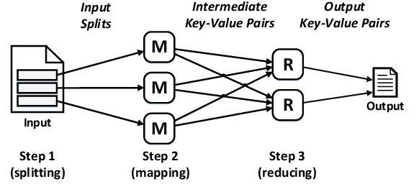
Access Pattern protected frameworks for SGX Applications
VC3: Trustworthy Data Analytics in the Cloud Using SGX [1]
Secure MapReduce Framework
Utilized unmodified Hadoop
Execute Map & Reduce function in Enclave
Protect privacy and integrity of data
Limitations:
  Does not discuss the security
    Sort
    Grouping
    Shuffling
  Leaks Group size
  Does not provide record level access pattern protections
[1] VC3: Trustworthy Data Analytics in the Cloud Using SGX, Schuster et al., S&P’ 2015

Slide 22
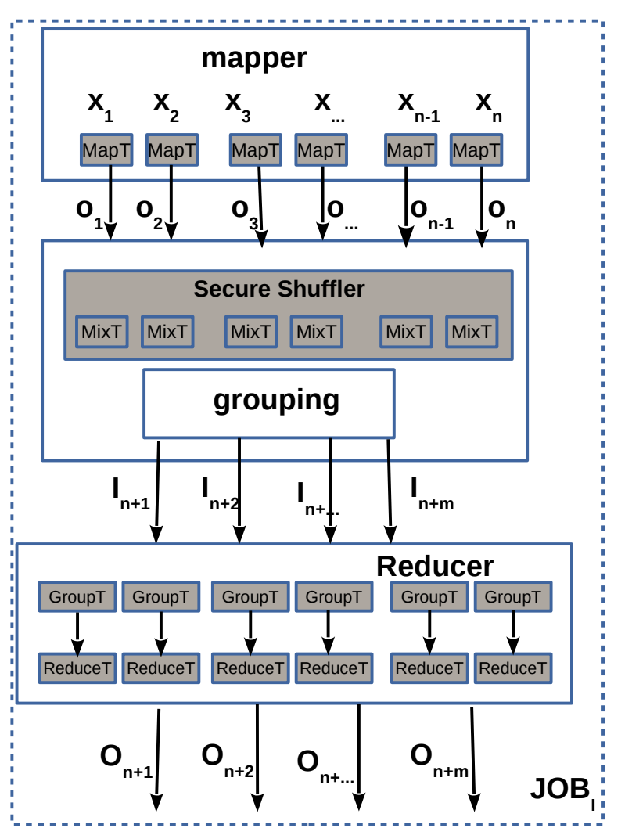
Access Pattern protected frameworks for SGX Applications
M²R: Enabling Stronger Privacy in MapReduce Computation Secure MapReduce Framework [1]
Modified the Hadoop framework
Protect privacy and integrity of data
Major Contribution: Perform Secure Shuffling
  Breaks the connection between input and reduced result
Perform MergeSort on Encrypted records in untrusted memory
Limitations:
  Leaks Group size of encrypted tuples
  Does not provide record level access pattern protections
[1] M2R: Enabling Stronger Privacy in MapReduce Computation, Dinh et al., Usenix’ 2015

Slide 23
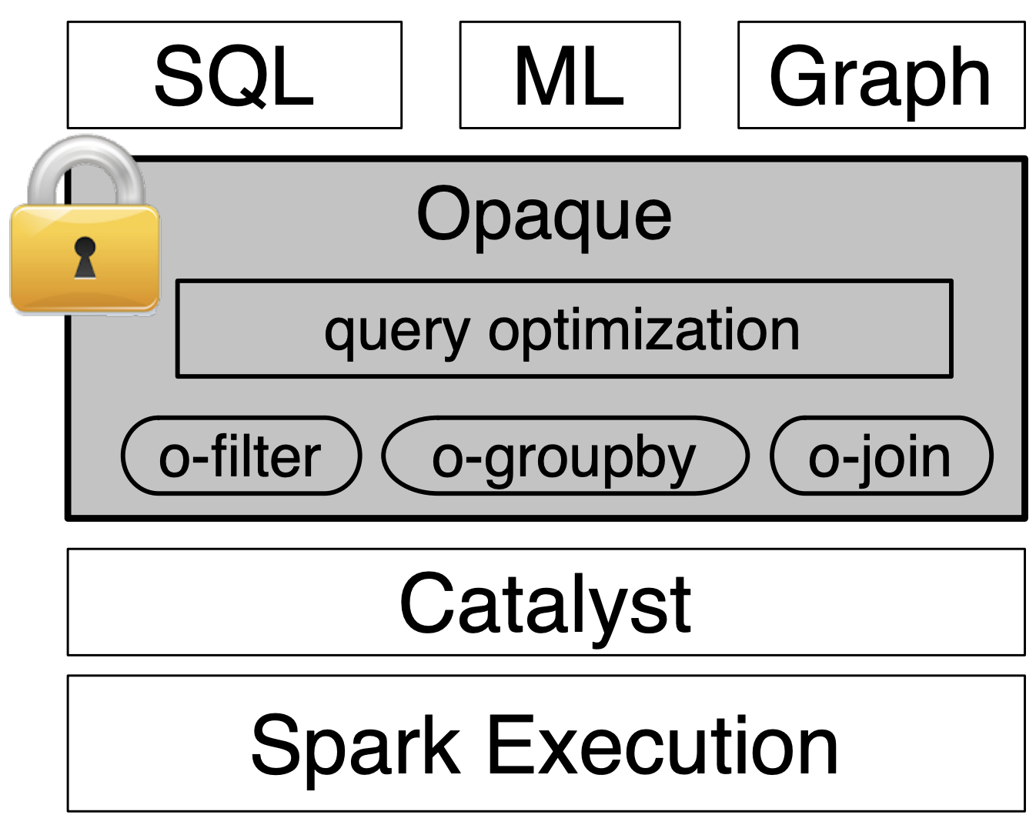
Access Pattern protected frameworks for SGX Applications
Opaque: An Oblivious and Encrypted Distributed Analytics Platform [1]
An access-pattern protected framework for Spark System
Built on top of Spark Execution Engine
Addressed both network bandwidth and memory access-pattern
Provides oblivious operator-based technique: oblivious filter, aggregation, join, etc.
Limitations:
  Covers limited algorithms
  Does not provide record level access pattern
[1] Opaque: An Oblivious and Encrypted Distributed Analytics Platform, Zheng et al, Usenix’ 2017

Slide 24
Memory Targeted Access Patterns (Cont.)
Page Access Attacks and Mitigation Methods

Slide 25
Page access attacks (Cont.)
Page Access Attacks:
  (1) Methods utilizing page-fault interrupts
  (2) Other methods
Attack | Papers
Page-Fault Interrupts | Y. Xu et al. 2015 Shinde et a. 2015 Wang et al. 2017 sassy et al. 2018 Ahmed et al. 2018 Gyselinck et al. 2018
Others | J. Van et al. 2017 Bulck et al. 2017

Slide 26
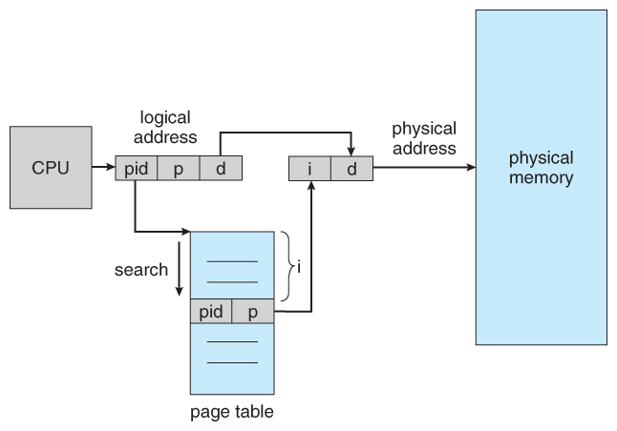
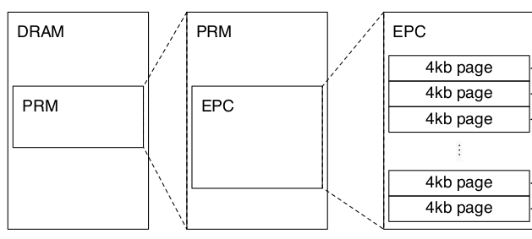
Page-fault interrupt
Powerful adversary compromises OS memory modules
Enforce CPU to raise page faults
CPU Memory Page Management (Simplified)
Enclave Page Cache (EPC) Architecture
[1] “Controlled-channel attacks: Deterministic side channels for untrusted operating systems,”, Xu et al, S&P 2015
[2] “Preventing Your Faults From Telling Your Secrets: Defenses Against Pigeonhole Attacks”, Shinde et al, 2015

Slide 27
Page Access Pattern Attacks using page-fault
Controlled Channel Attack
  Manipulating page table entries
  Load only minimum number of pages
  Will incur page-fault in every statement
Load 3 pages
1 page for op code
2 page for operands
CPU Memory Page Management (Simplified)
[1] “Controlled-channel attacks: Deterministic side channels for untrusted operating systems,”, Xu et al, S&P 2015
[2] “Preventing Your Faults From Telling Your Secrets: Defenses Against Pigeonhole Attacks”, Shinde et al, 2015

Slide 28
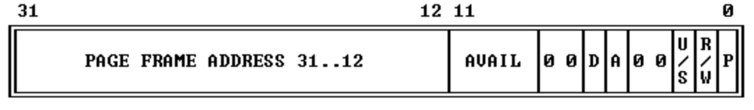
Beyond Page-fault Attack / attack without page-fault
Achieve Single Stepping
  Analyze avg. CPU speed to perform single statement
  Manipulate APIC Timer to call interrupt for each statement
Observing Page-table entries
  Accessed Bit – page reading
  Dirty Bit – page writing
Accessed Bit
Fig: Structure of Page-table entries
Dirty Bit
[1] SGXStep,” in Proc. 2nd Work. Syst. Softw. Trust. Exec., Bulk et al., SysTEX’ 2017
[2] Telling Your Secrets Without Page Faults, Bulck et al., Usenix’ 2017
Notes:
APIC (Advanced Programmable Interrupt Controller)

Slide 29
Exploiting Page level access pattern
Data Page Access
Code Page Access
Page address
Pages
if (input)
func1();
else
func2();
0xa1
0xa2
0xa3
1st
Page X
3rd
0xa4
If (input)
0xa5
0xa6
2nd
Page Y
Page Z
0xa7
Func1()
Func2()
0xa8
Page fault sequence
0xa3, 0xa6, 0xa3
Page fault sequence
X, Y
Page fault sequence
X, Z
[1] “Controlled-channel attacks: Deterministic side channels for untrusted operating systems,”, Xu et al, S&P 2015
[2] “Preventing Your Faults From Telling Your Secrets: Defenses Against Pigeonhole Attacks”, Shinde et al, 2015
[3] SGXStep,” in Proc. 2nd Work. Syst. Softw. Trust. Exec., Bulk et al., SysTEX’ 2017
[4] Telling Your Secrets Without Page Faults, Bulck et al., Usenix’ 2017

Slide 30
Mitigation Strategies for Page Level Access Pattern
Use Oblivious primitives / programming techniques
Adopt Oblivious Algorithms for in-enclave computation as well
Verifying Obliviousness using code analyzer
Approach | Papers
Oblivious Primitives/ programming techniques | Constable et al. 2018 Sassy et al. 2018 Ahmed et al. 2018
Oblivious algorithms | Batcher 1968 Dinh et al. 2016 Zheng et al. 2017 Krastnikov et al. 2020 Chu et al. 2021
Verifying Obliviousness | Son et al. 2021

Slide 31
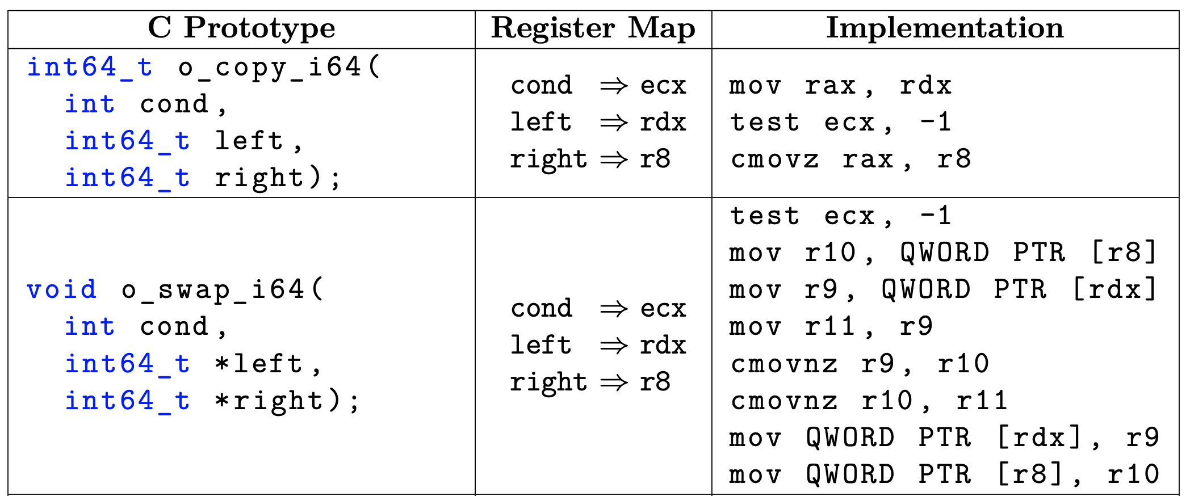
Mitigation Strategies using Oblivious primitives
Leveraging CMOV instruction from Intel x86 instruction set [1][2][3]
CMOV is an opcode for conditional move operation
Example usage: CMOV SRC,DST
Regardless of condition, the memory operand is read/accessed
[1] ibOblivious: A C++ Library for Oblivious Data Structures and Algorithms, Constable et al., 2018
[2] Obliviate: A data oblivious file system for intel sgx , Ahmed et al., NDSSS’ 2018
[3] ZeroTrace : Oblivious Memory Primitives from Intel SGX, Sassy et al., NDSS’ 2018

Slide 32
Mitigation Strategies using Oblivious primitives (Cont.)
Oblivious array access in Enclave
  Iterate though entire array and access all the array element
F
F
CMOV
Input
T
F
F
[1] ibOblivious: A C++ Library for Oblivious Data Structures and Algorithms, Constable et al., 2018
[2] Obliviate: A data oblivious file system for intel sgx , Ahmed et al., NDSSS’ 2018
[3] ZeroTrace : Oblivious Memory Primitives from Intel SGX, Sassy et al., NDSS’ 2018

Slide 33
Mitigation Strategies using Oblivious Algorithms
All the oblivious algorithms that we discussed earlier can be adopted to Enclave’s page level access patterns as well. [1-5]
Example:
  Oblivious sort
  Oblivious Join
  Oblivious Merge, etc.
Perform block level obliviousness in untrusted memory [2][3]
Perform record level obliviousness inside enclave memory. [6][7]
All the algorithms need to adopt oblivious primitives. [6][7]
Verify obliviousness using code analyzer (oblicheck). [8]
[1] Opaque: An Oblivious and Encrypted Distributed Analytics Platform, Zheng et al, Usenix’ 2017
[2] Efficient oblivious database joins, Krastnikov et al., Proc. VLDB 2020.
[3] M2R: Enabling Stronger Privacy in MapReduce Computation, Dinh et al., Usenix’ 2015
[4] Sorting networks and theirapplications, Batcher. InProceedings Spring JointComputer Conference, AFIPS ’ 1968
[5] Differentially Oblivious Database Joins, Chu et al., ITC 2021
[6] Obliviate: A data oblivious file system for intel sgx , Ahmed et al., NDSSS’ 2018
[7] ZeroTrace : Oblivious Memory Primitives from Intel SGX, Sassy et al., NDSS’ 2018
[8] ObliCheck: Efficient verification of oblivious algorithms with unobservable state, son et al., Usenix 2021

Slide 34
Side Channel Attacks (Cont.)
Side Channel Attacks:
Memory Targeted Attacks and countermeasures
Micro-architectural Level Attacks and countermeasures

Slide 35
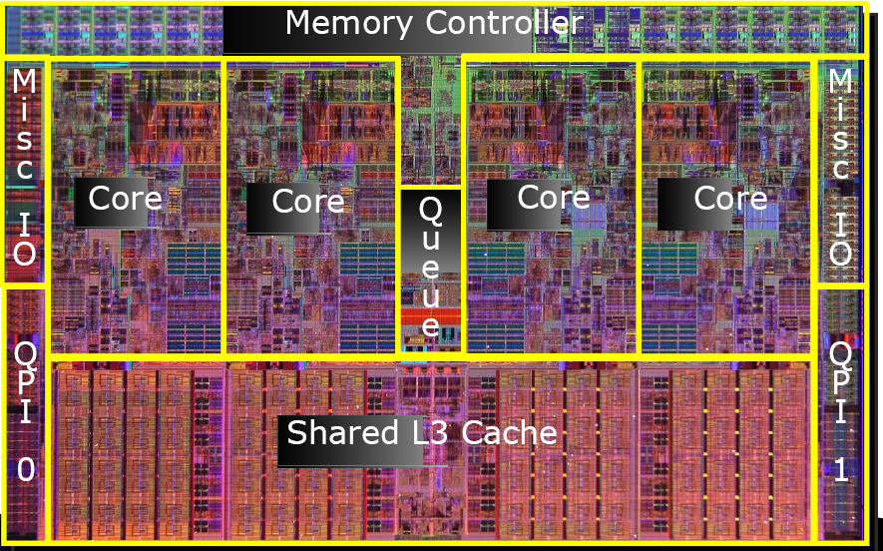
Micro-architectural level Attacks
Exploit CPU’s micro-architectural execution
Attack | Papers
Cache Timing Attack | Yarom et al., 2014 Osvik et al., 2006 Tromer et al., 2010 Gruss et al., 2015 Gruss et al., 2016
Speculative Execution Attack | Kocher et al., 2019, Lipp et al., 2018, O’Keeffe et al, 2018 Chen et al., 2019 Bulck et al, 2018 Weisse et al., 2018 Bulck et al., 2019
Fault- Injection Attack | K. Murdock et al., 2020

Slide 36

Micro-architectural level Attacks (Cont.)
Cache Timing
+
Speculative Execution
+
Page-fault

Slide 37
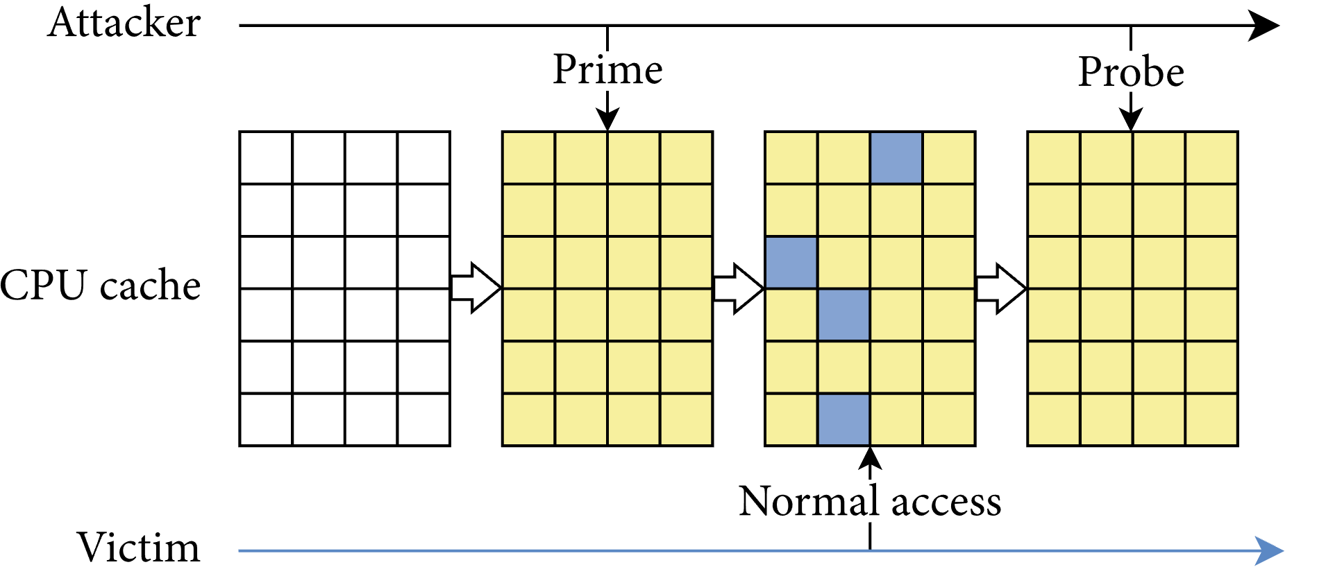
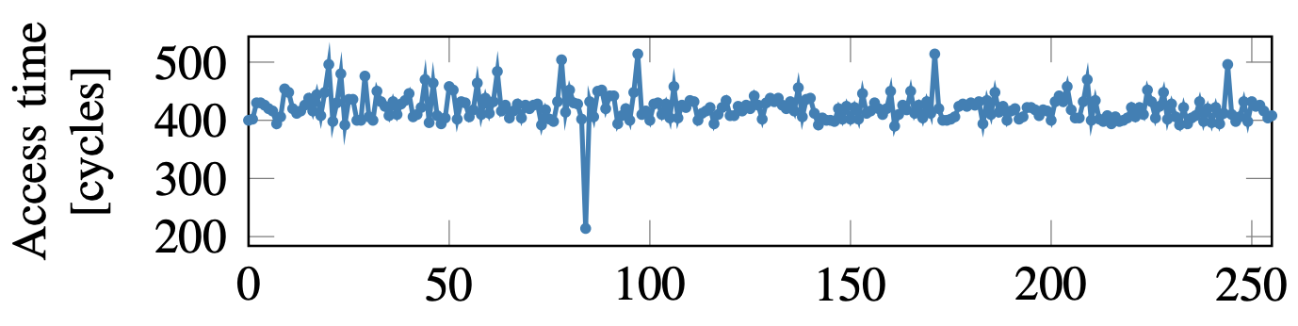
Cache Timing Attack
Completely evict victim data from cache
Trigger a victim data access
Access attacker memory again and see which cache sets are slow
[1] Cache Attacks and Countermeasures: The Case of AES, osvik et al., 2006
[2] FLUSH+RELOAD: A high resolution, low noise, L3 cache side-channel attack, Yarom et al., Usenix’ 2014
[3] Flush+Flush: A Fast and Stealthy Cache Attack, Gruss et al., Springer, 2016

Slide 38
Mitigations for Cache Attack
Time Blinding [1]
  Restrict accessing actual CPU cycles
  Overriding the interface with virtual clock-cycles
Time Sharing. [2]
  Utilizing the time-sharing property of the cache
  During context switch between VMs, flush cache
Resource Isolation [3]
  Turning off hyperthreading
  Resource must be isolated during Enclave applications
  Cache line will be exclusively executed in Enclave’s applications
[1] Eliminating fine grained timers in xen, vVattikonda, et. al, ACM Cloud Comp Sec, 2011
[2] A server-side solution to cache-based side-channel attacks in the cloud, Godfrey et al., IEEE Cloud, 2013
[3] M. Corp, Microsoft azure, March 2021,

Slide 39
Speculative Execution
Why Speculative execution?
Problem
  Program execution has data dependent branching
  CPU does not know which branch to execute
Solution
  Optimization
  Speculatively executes both branches
if (input < limit)
statement_1;
statement_2;
else
statement_2;
statement_3;

Slide 40


Speculative Execution Attack
if (x < array1_size)
y = array2[array1[x]];
meltdown:
mov al, byte[rcx]
shl rax, 0xc
jz meltdown
mov rbx, qword[rbx + rax]
Attacker memory
Victim Memory
Loaded to Cache
[1] Spectre attacks: Exploiting speculative execution. Kocher et al., CoRR, abs/1801.01203, 2018
[2] Meltdown: Reading kernel memory from user space, Lipp et al., Usenix, 2018

Slide 41
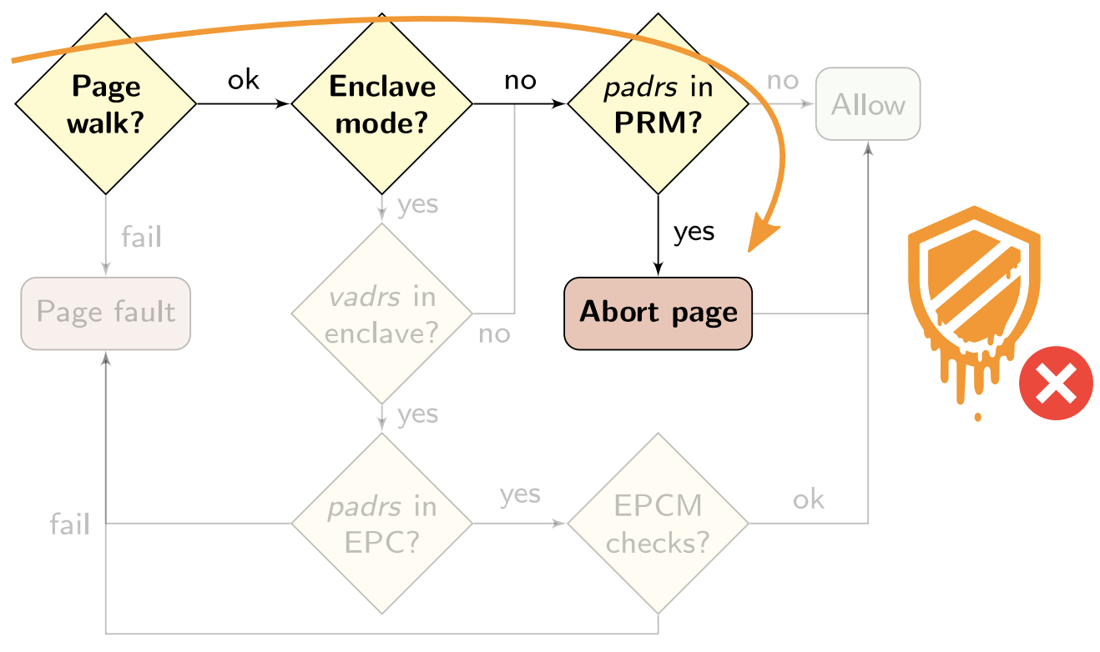
Exploiting Speculative Execution
By default, SGX is not vulnerable from speculative execution attack
SGX Memory Management Unit (MMU) sanitize untrusted address translations
If a requested memory is is from SGX, MMU return ”Abort Page”
[1] FORESHADOW: Extracting the Keys to the Intel SGX Kingdom with Transient Out-of-Order Execution, Bulck et al., Usenix 2018

Slide 42
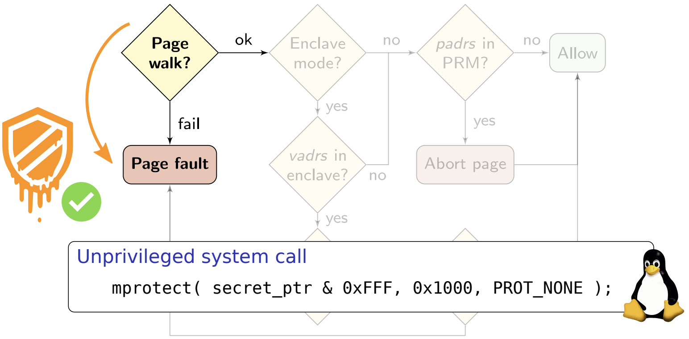
Exploiting Speculative Execution
Foreshadow Attack:
  Raising Page fault while accessing the memory can delay ”Abort page” semantics
  While CPU loading requested page, speculative execution start executing the branches
  After loading the page, CPU discard the branch, but the memory is already loaded to cache
[1] FORESHADOW: Extracting the Keys to the Intel SGX Kingdom with Transient Out-of-Order Execution, Bulck et al., Usenix 2018

Slide 43

Mitigation for Speculative execution Attack
Mitigation:
Out of scope for application designers or developers.
Intel addressed this as a sophisticated attack. [1]
Named it as ”L1 Terminal Fault”
Intel released firmware patches at the microarchitectural level.
[1] Intel.Resources andr esponse to side channel l1terminalfault. Link:https://www.intel.com/content/www/us/en/architecture- and-technology/l1tf.html.

Slide 44
Summary of our survey
Non-TEE solution are slow and not practical for data intensive applications
TEE is the future: solves privacy, integrity and efficiency together
But, we cannot ignore side-channel attacks
  Memory-targeted Attacks
  Micro-architectural Attacks
It is an active state of the art research problem
  Discover more attacks
  Discover scalable oblivious algorithms/frameworks

Slide 45
Future Research Directions
Research on Attacks
Based on attack trend we expect more attacks are yet be discovered
  Memory-targeted attacks
  Micro-architectural attacks
More known vulnerabilities
  Make SGX more attack resilient

Slide 46
Future Research Directions
Research on Oblivious Algorithms
We have a few oblivious algorithms
  Should cover all type of algorithms
    Data Structure, Graph algorithms, Searching, etc.
Existing algorithms are slow
  Should focus on efficient and scalable Oblivious algorithms

Slide 47
Future Research Directions
Research on Access-Pattern protected frameworks
Existing access-pattern protected frameworks
  Not cover all types of computing
  Deprecated
Should focus on frameworks
  Resilient to modern attacks
  Scalable/efficient solution

