Slide 1
Data mining and machine learning
A brief introduction and privacy issues

Slide 2
Outline
A brief introduction to learning algorithms
  Classification algorithms
  Clustering algorithms
Addressing privacy issues in learning
  Single dataset publishing
  Distributed multiple datasets
  How data is partitioned

Slide 3
A quick review
Machine learning algorithms
  Supervised learning (classification)
    Training data have class labels
    Find the boundary between classes
  Unsupervised learning (clustering)
    Training data have no labels
    Similarity measure is the key
    Grouping records based on the similarity measure

Slide 4
A quick review
Good tutorials
  Andrew Ng’s “machine learning” class on youtube
  “Top 10 data mining algorithms”
    www.cs.uvm.edu/~icdm/algorithms/10Algorithms-08.pdf
    We will review the basic ideas of some algorithms

Slide 5









C4.5 decision tree (classification)
Based on ID3 algorithm
Convert decision tree to rule set
  From the root to a leave → a rule
Prune the rules
  Using cross validation
Split data
to N folds
In each
round
training
validating
testing
Testing the generalization power
For choosing the best parameters
Final result: the average of N testing results

Slide 6

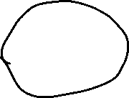






Naïve bayes (classification)
Two classes: 0/1, feature vector: x (x1,x2,…, xn)
Apply bayes rule:
Assume independent
features :
Easy to count f(xi|class label) with the training data

Slide 7


K nearest neighbor (classification)
“instance-based learning”
Classifying the point
Decision area: Dz
More general: kernel methods

Slide 8



Linear classifier (classification)
w^{T}x + b = 0
w^{T}x + b > 0
w^{T}x + b < 0
f(x) = sign(w^{T}x + b)
Examples:
Perceptron
Linear discriminant analysis(LDA)

Slide 9
There are infinite number of linear separators
Which one is optimal?

Slide 10


Support Vector Machine (classification)
Distance from example x_{i} to the separator is
Examples closest to the hyperplane are support vectors.
Margin ρ of the separator is the distance between support vectors.
ρ
Maximizing:
r
Extended to handle:
Nonlinear
Noisy margin
Large datasets

Slide 11
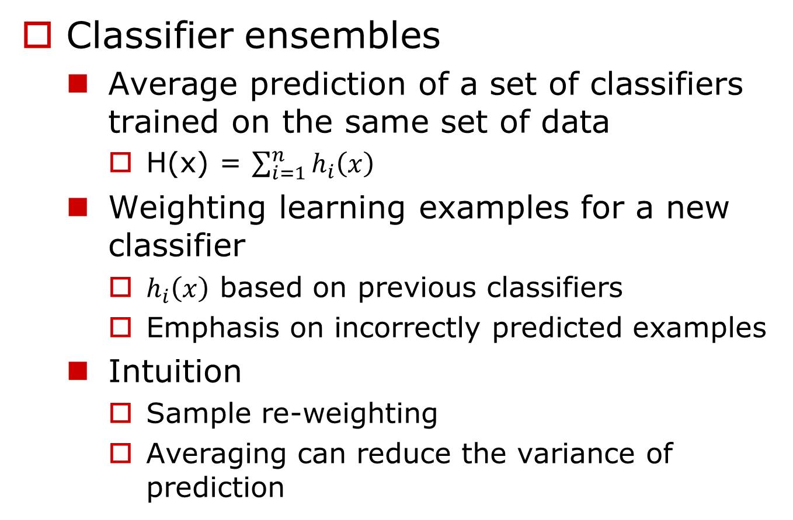


Boosting (classification)

Slide 12
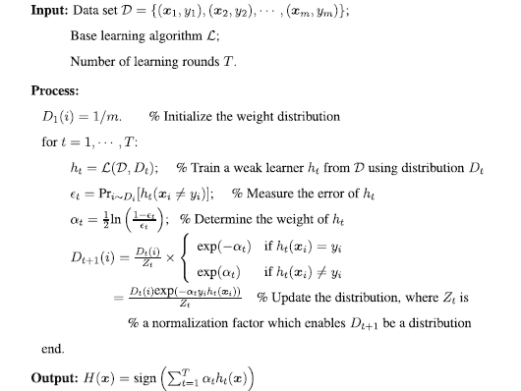
AdaBoost
  Freund Y, Schapire RE (1997) A decision-theoretic generalization of on-line learning and an application to boosting. J Comput Syst Sci

Slide 13





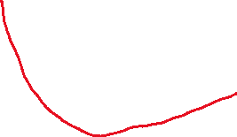

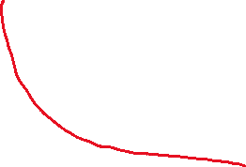

Gradient boosting
  J. Friedman: stochastic gradient boosting, http://citeseer.ist.psu.edu/old/126259.html

Slide 14
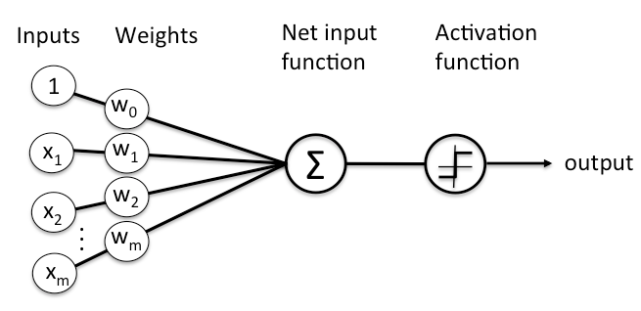
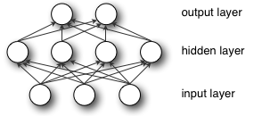












Deep neural networks (DNN)
single neuron:
Neural network

Slide 15
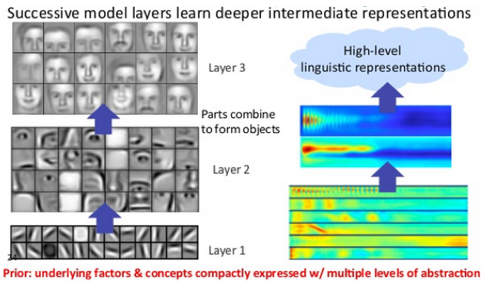
Deep networks
  Advantage: automatic feature extraction & evaluation

Slide 16


Clustering (unsupervised learning)
Definition of similarity measures
  Point-wise
    Euclidean
    Cosine ( document similarity)
    Correlation
    …
  Set-wise
    Min/max distance between two sets
    Entropy based (categorical data)

Slide 17

Types of clustering algorithm
Hierarchical
  1. Merging most similar pairs each step
  2. Until reaching desired number of clusters
Partitioning (k-means)
  1. Set initial centroids
  2. Partition the data
  3. Adjust the centroids
  4. Iterate on 2 and 3 until converging
Other classification of algorithms
  Aglommerative (bottom-up) methods
  Divisive (partitional, top-down)

Slide 18
Challenges in Clustering
Efficiency of the algorithm –large datasets
  Linear-cost algorithms: k-means
  However, the costs of many algorithms are quadratic
  Perform a three-phase processing
    Sampling
    Clustering
    Labeling

Slide 19
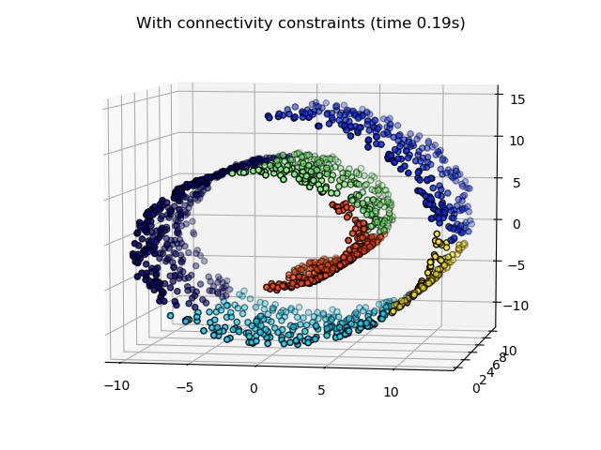

Challenges in Clustering
Irregularly shaped clusters and noises

Slide 20
Challenges in clustering
Determine the optimal number of clusters
  “Elbow” or “knee” based methods
  Global optimal measure: silhouette coefficient method

Slide 21
Sample clustering algorithms
Typical ones
  Hierarchical clustering
  Kmeans
  Spectral clustering
A lot of clustering algorithms addressing different challenges
  A good (old) survey:
    AK Jain etc. Data Clustering: A Review, ACM Computing Surveys, 1999

Slide 22
Kmeans illustration
Randomly select centroids
Assign cluster label of each point according to the distance to the centroids

Slide 23
kmeans
Recalculate the centroids
Reclustering
Repeat, until the cluster labels do not change, or the changes of centroids are very small

Slide 24
Hierarchical clustering illustrated
Start with each point as a cluster
Merge closest clusters in each iteration
d3
d5
d1
d3,d4,d5
d4
d2
d1,d2
d4,d5
d3

Slide 25


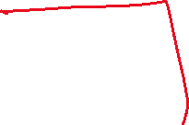





PPDM issues
How data is collected
  Single party releasing data
    Publishing or outsourcing?
  Multiparty collaboratively mining data
    Pooling data
    Cryptographic protocols
How data is partitioned (multiparty)
  Horizontally
  vertically

Slide 26

Single party
Data perturbation (hiding values)
  Additive perturbation, for decision tree (publishing)
  Multiplicative perturbation, for many classifiers and clustering algorithms (outsourcing)
  Differential privacy (publishing)
Anonymization (hiding IDs)
  Top-down/bottom-up: decision tree

Slide 27





Multiple parties
user 1
user 1
user 1
network
Perturbed
data
Party 1
Party 2
Party n
server
data
data
data
data
Service-based computing
Peer-to-peer computing
Perturbation & anonymization
Cryptographic approaches

Slide 28
How data is partitioned for multi-party collaborative mining
Horizontally partitioned
  All additive (and some multiplicative) perturbation methods
  Protocols
    Kmeans, svm, naïve bayes, bayesian network…
Vertically partitioned
  All additive perturbation methods
  Protocols
    Kmeans, bayesian network…

Slide 29


Challenges and opportunities
Data mining algorithms raise the major challenges in using private data
For many PP techniques, we need to develop corresponding PP versions of algorithms
  Typically more expensive
  Sometimes, involve trade-offs
    Privacy vs. data utility/model quality
    Privacy vs. costs

