Slide 1
Data Perturbation: the Basic Problem and Techniques

Slide 2
Purpose
Show some history of confidentiality preserving methods for privacy-preserving data mining
  Weaknesses
  Reasons behind the development of new methods, e.g., differential privacy, crypto methods, and TEE
They are still useful for some clearly defined scenarios

Slide 3
Outline – additive perturbation
Motivation
Definition
Some (ad-hoc) Privacy metrics
Distribution reconstruction methods
Application in privacy-preserving data mining
attacks

Slide 4
Motivation
Web-based computing
Observations
  Only a few sensitive attributes need protection
  Allow individual user to perform protection with low cost
  Some data mining algorithms work on distribution instead of individual records
user 1
user 1
user 1
Private
info
Web
Apps
data

Slide 5
Definition of dataset
  Column by row table
  Each row is a record, or a vector
  Each column represents an attribute
  We also call it multidimensional data
2 records in the 3-attribute dataset
A | B | C
10 | 1.0 | 100
12 | 2.0 | 20
A 3-dimensional record
A | B | C
10 | 5 | 100
12 | 15 | 20
B+ Noise ~ N(0, 10)

Slide 6
Additive perturbation
Definition
  Z = X+Y
  X is the original value, Y is random noise and Z is the perturbed value
  Data Z and the parameters of Y are published
    e.g., Y is Gaussian N(0,1)
History
  Used in statistical databases to protect sensitive attributes (late 80s to 90s)
Benefit
  Allow distribution reconstruction
  Allow individual user to do perturbation
    Need to publish the noise distribution, however

Slide 7
Applications in data mining
  Able to reconstruction column-wise distribution (approximately)
Column-distribution based algorithms
  Decision tree
  Naïve Bayes classifier

Slide 8
Major issues
Privacy metrics
Preserving information
  Distribution reconstruction algorithms
  Loss of information
  A tradeoff between loss of information and privacy

Slide 9
Privacy metrics for additive perturbation
Variance/confidence based definition
Mutual information based definition

Slide 10
Variance/confidence based definition
Method
  Based on attacker’s view: value estimation
    Knowing perturbed data, and noise distribution
    No other prior knowledge
  Estimation method
Confidence interval: the range having c% prob
that the real value is in
Perturbed value
Y: zero mean, std σ
is the important factor, i.e., var(Z-X) = σ²
Given Z, X is distant from Z in the Z+/-σ range with c% conf
We often ignore the confidence c% and use σ to represent the
difficulty of value estimation.

Slide 11
Problem with Var/conf metric
No knowledge about the original data is incorporated
  Knowledge about the original data distribution
    Range of original values, etc.
    which will be discovered with distribution reconstruction, in additive perturbation
    can be known in prior in some applications
  Other prior knowledge may introduce more types of attacks
    Privacy evaluation needs to incorporate these attacks

Slide 12
Mutual information based method
  incorporating the original data distribution
  Concept: Uncertainty → entropy
    Difficulty of estimation… the amount of privacy…
  Intuition: knowing the perturbed data Z and the noise Y distribution, how much uncertainty of X is reduced.
    Z,Y do not help in estimate X → all uncertainty of X is preserved: privacy = 1
    Otherwise: 0<= privacy <1

Slide 13
some information theory
Definition of mutual information
  Entropy: h(A) → evaluate uncertainty of A
    - sum_{a in A} p(a) log p(a)
    Not easy to estimate → high entropy
    Distributions with the same variance → uniform has the largest entropy
  Conditional entropy: h(A|B)
    sum_{b in B} p(b) h(A|B=b)
    If we know the random variable B, how much is the uncertainty of A
    If B is not independent of A, the uncertainty of A can be reduced, (B helps explain A) i.e., h(A|B) <h(A)
  Mutual information I(A;B) = h(A)-h(A|B)
    the information brought by B in estimating A
    Note: I(A;B) == I(B;A)

Slide 14
Inherent privacy of a random variable
  Using uniform variable as the reference (the maximum case), denoted as 2^{h(A)}
MI based privacy metric
  P(A|B) = 1-2^{-I(A;B)} defines the lost privacy
  I(A;B) =0 → B does not help estimate A
    Privacy is fully preserved, the lost privacy P(A|B) =0
  I(A;B) >0 → 0<P(A|B)<1
Calculation for additive perturbation:
  I(X;Z) = h(Z) – h(Z|X) = h(Z) – h(Y), due to p(X+Y|X) = p(Y)

Slide 15
Distribution reconstruction
Problem: Z= X+Y
  Know noise Y’s distribution Fy
  Know the perturbed values z1, z2,…zn
  Estimate the distribution Fx
Basic methods
  Rakesh’s method: Bayes method
  EM estimation: maximum likelihood

Slide 16

Rakesh’s algorithm
Find distribution P(X|X+Y)
three key points to understand it
  Bayes rule:
    P(X|X+Y) = P(X+Y|X) P(X)/P(X+Y)
  Conditional prob
    f_{x+y}(X+Y=w|X=x) = f_{y}(w-x)
  Prob at the point a uses the average of all sample estimates
Using fx(a)?

Slide 17
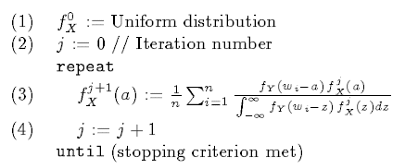
The iterative algorithm
Stop criterion: the difference between two consecutive fx
estimates is small

Slide 18
Weakness of Rakesh’s algorithm
  No convergence proof
  Don’t know if the iteration gives the globally optimal result

Slide 19

Make it more efficient…
Bintize the range of x
Discretize the previous formula
x
m(x) mid-point of the bin that x is in
Lt = length of interval t

Slide 20

Can use EM algorithm to solve it
Using discretized bins to approximate the distribution
Density (the height) of Bin i is
notated as θi
x
I(x) is an indicator function: I(x) =1 if x in the range
For a specific x, f (x) returns some theta_i

Slide 21
EM algorithm has good properties
  Unique global optimal solution
  Θ^ converges to the MLE solution

Slide 22
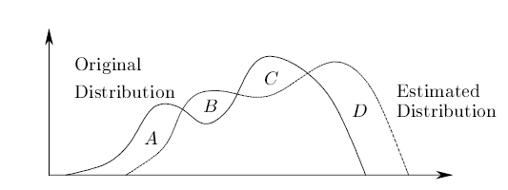

Evaluating loss of information
The information that additive perturbation wants to preserve
  Column distribution
generic metric
  Difference between the estimate and the original distribution

Slide 23
More distribution distance measures
KL divergence
Cross entropy (frequently used in deep learning)
OTDD (dataset-level distance)
FID (used in image data reconstruction/regeneration – in GAN research)

Slide 24
Evaluating loss of information
Ultimate utility metric
  Modeling quality
    The accuracy of classifier, if used for classification modeling
  Evaluation method
    Accuracy of the classifier trained on the original data
    Accuracy of the classifier trained on the reconstructed distribution

Slide 25
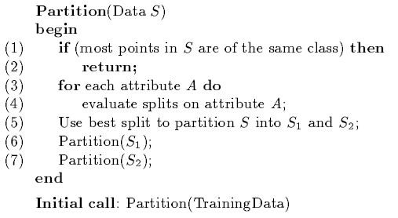
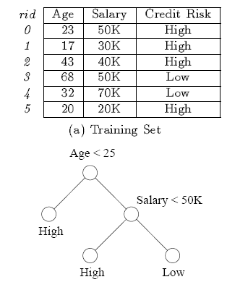
Data Mining with Additive Perturbation
Example: decision tree
A brief introduction to decision tree algorithm
  There are many versions…
  One version working on continuous attributes

Slide 26
A bit more details…
Split evaluation
  gini(S) = 1- sum(pj^2)
    Pj is the relative frequency of class j in S
  gini_split(S) = n1/n*gini(S1)+n2/n*gini(S2)
  The smaller the better
Procedure
  Get the distribution of each attribute
  Scan through each bin in the attribute and calculate the gini_split index → problem: how to determine pj
  The reconstruction algorithm applies …
x

Slide 27
When to reconstruct distribution
Global – calculate once
By class – calculate once per class
Local – by class at each node
Empirical study shows
  By class and Local are more effective

Slide 28
Problems with these studies
Privacy evaluation
  Didn’t consider attacking methods
    Methods used to reconstruct the original data
    Mostly used in signal processing
Loss of information (or utility)
  Negatively related to privacy
  Not directly related to modeling
    Accuracy of distribution reconstruction vs. accuracy of classifier ?

Slide 29
Summary (so far)
We discussed the basic methods with additive perturbation
  Definition
  Some ad-hoc privacy metrics
  Distribution reconstruction

Slide 31
Additive Data Perturbation: data reconstruction attacks

Slide 32
Major weakness
Never clearly defined the concept of “security”(confidentiality)
  Assume added noises are sufficient to protect the confidentiality
  Assume the only attack available is to “estimate the original values based on the perturbed values”

Slide 33
Outline
Overview
  Paper “Deriving Private Information from Randomized Data”
Data Reconstruction Methods
  The idea is ”de-noising” with signal processing methods
    PCA-based method
    Bayes method
Comparison
Summary

Slide 34
Overview
Data reconstruction
  Z = X+R
  Problem: know Z and distribution of R → estimate the value of X
  Extend it to matrix
    X contains multiple dimensions
    Or folding the vector X → matrix

Slide 35
Two major approaches
Principle component analysis (PCA) based approach
Bayes analysis approach
Basic ideas are from signal processing

Slide 36
Variance and covariance
Definition
  Random variable x, mean μ
  Var(x) = E[(x- μ)²]
  Cov(xi, xj) = E[(xi- μi)(xj- μj)]
  For multidimensional case,
    X=(x1,x2,…,xm)
    Covariance matrix
    If each dimension xi has mean zero
    cov(X) = 1/n X^{T}*X

Slide 37
PCA intuition
Vector in space
  Original space → base vectors E={e1,e2,…,em}
    Example: 3-dimension space
      x,y,z axes corresponds to {(1 0 0),(0 1 0), (0 0 1)}
  If we want to use the red axes to represent the vectors
    The new base vectors U=(u1, u2)
    Transformation: matrix X → XU
u1
X₂
u2
X₁

Slide 38
Why do we want to use different bases?
  Actual data distribution can be possibly described with lower dimensions
u1
X₂
X₁
Ex: projecting points to U1, we can use one dimension (u1)
to approximately describe all these points
➔The key problem: finding these directions that maximize variance of
the points. These directions are called principle components.

Slide 39
How to do PCA?
Calculating covariance matrix:
C =
“Eigenvalue decomposition” on C
  Matrix C: symmetric
  We can always find an orthonormal matrix U
    U*U^{T} = I
    So that C = U*B*U^{T}
    B is a diagonal matrix
X is normalized to mean zero for each dimension; n is the number of rows in X

Slide 40
Explanation of PCA
Explanation: di in B are actually the variance in the transformed space, and U is the transformation matrix
  1/n X^{T}*X =U*B*U^{T}
  ➔ 1/n (XU)^{T}*(XU) =B

Slide 41
Look at the diagonal matrix B (eigenvalues)
  We know the variance in each transformed direction
  We can select the maximum ones (e.g., k of d elements) to approximately describe the total variance
Approximation with maximum eigenvalues
  Select the corresponding k eigenvectors in U →U’
  Transform X → XU’
    XU’ has only k dimensional
Use of PCA
  Dimensionality reduction
  Noise filtering

Slide 42
PCA-based reconstruction
Cov matrix for Z=X+R
  Elements in R is iid with variance σ²
  Cov(Xi+Ri, Xj+Rj)
  = cov(Xi,Xi) + σ² , for diagonal elements
  cov(Xi,Xj) for i!=j
  Therefore, removing σ² from the diagonal of cov(Y), we get the covariance matrix for X

Slide 43
Reconstruct X
  We have got C=cov(X)
  Apply PCA on cov matrix C
    C = U*B*U^{T}
  Select major principle components and get the corresponding eigenvectors U’
  Reconstruct X
    X^ = Z*U’*U’^{T}
    Understanding it: X’ is X in the transformed space
    X’ =X*U ➔ X=X’*U^{T} ~ X’*U’^{T}
    approximate X’ with Z*U’ and plugin
Error comes from here

Slide 44
Error analysis
    X^ = Z*U’*U’^{T} ➔ X^ = (X+R)*U’*U’^{T}
    The error item is R*U’*U’ ^{T}
    Mean square error is used to evaluate the quality of estimation
      xi and xi^ is single data item and its estimation: MSE = sum (xi-xi^) ²
    Result: MSE = p/m * σ ², is the variance of the noise

Slide 45
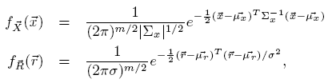
Bayes Method
Make an assumption
  The original data is multidimensional normal distribution
  The noise is is also normal distribution
Covariance matrix, can be approximated
with the discussed method.

Slide 46
Data
(x11,x12,…x1m) → vector
(x21,x22,…x2m) → vector
…

Slide 47
Problem:
  Given a vector yi, yi=xi+ri
  Find the vector xi
  Maximize the posterior prob P(X|Y)

Slide 48
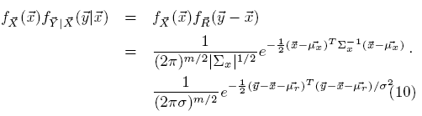

Again, applying bayes rule
Maximize this
f
Constant for all x
With f_{y|x} (y|x) = f_{R}(y-x), plug in the distributions fx and f_{R}
We find x to maximize:

Slide 49



It’s equivalent to maximize the exponential part
A function is maximized/minimized, when its derivative =0
i.e.,
Solving the above equation, we get

Slide 50
Reconstruction
  For each vector y, plug in the covariance, the mean of vector x, and the noise variance, we get the estimate of the corresponding x

Slide 51
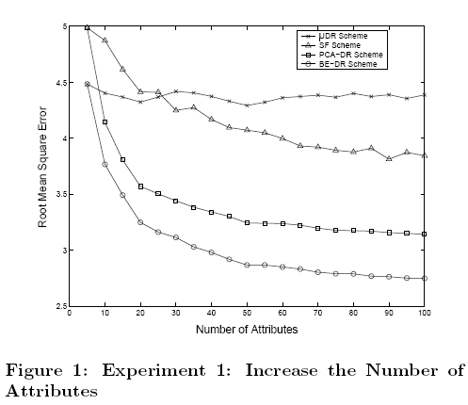
Experiments
Errors vs. number of dimensions
Conclusion: covariance between dimensions helps reduce errors

Slide 52
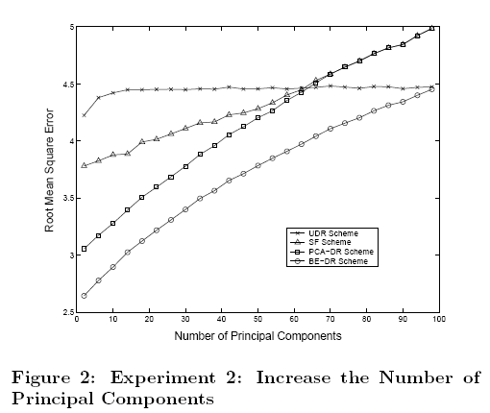
Errors vs. # of principle components
  # of PC : the correlation between dimensions
Conclusion: the # of principal components ~ the amount of noise

Slide 53
Discussion
The key: find the covariance matrix of the original data X
  Increase the difficulty of Cov(X) estimation ➔ decrease the accuracy of data reconstruction
Assumption of normal distribution for the Bayes method
  other distributions?

