Slide 1
Data Transformation

Slide 2
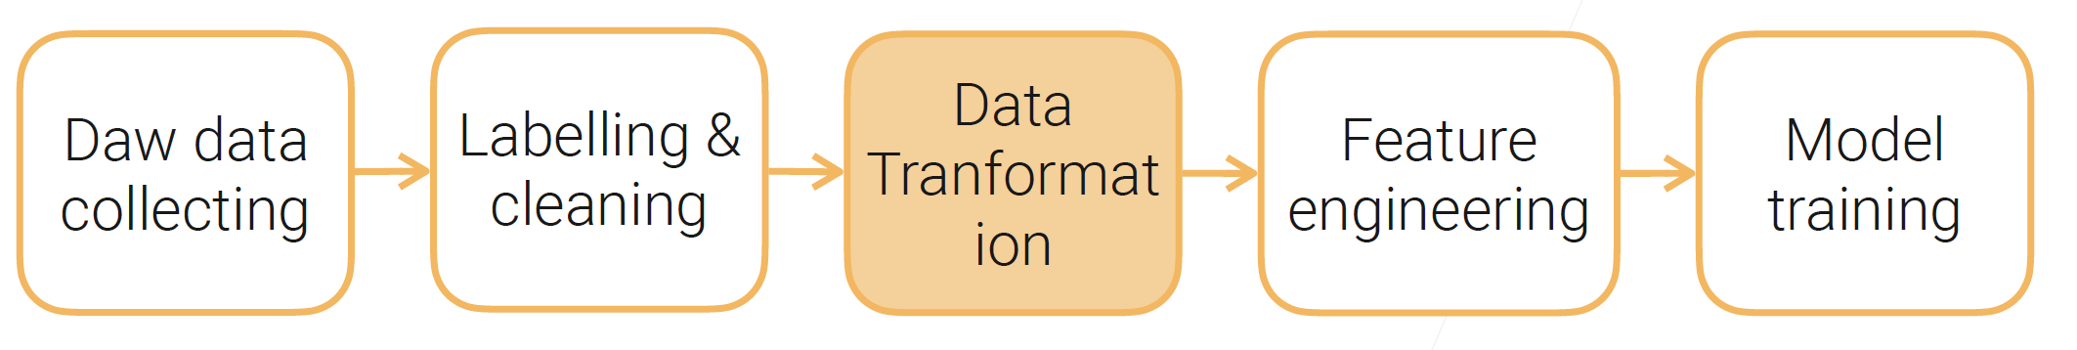
Why data transformation
ML algorithms prefer well defined fixed length (vector data), well-conditioned, nicely distributed numeric data
Next, we look at data transformation methods for different data types
Raw Data

Slide 3
Transformations
Tabular/vector data: normalization
Image data: cropping, compression, whitening
Video data: clipping
Text data: tokenization, normalization/lemmatization, stemming
➔ we focus on tabular and text data

Slide 4
Tabular Data: column/attribute-wise Normalization
Feature values are in different domains
  Some features have very large values, such as salaries [50k, 200k], others are relatively small, such as ages [0 – 100]
Cause problems
  Some supervised learning also sensitive to non-normalized data, such as SVM and DNNs -- The learning process becomes unstable, difficult to converge
  A few features dominating distances between vectors – affecting clustering results

Slide 5
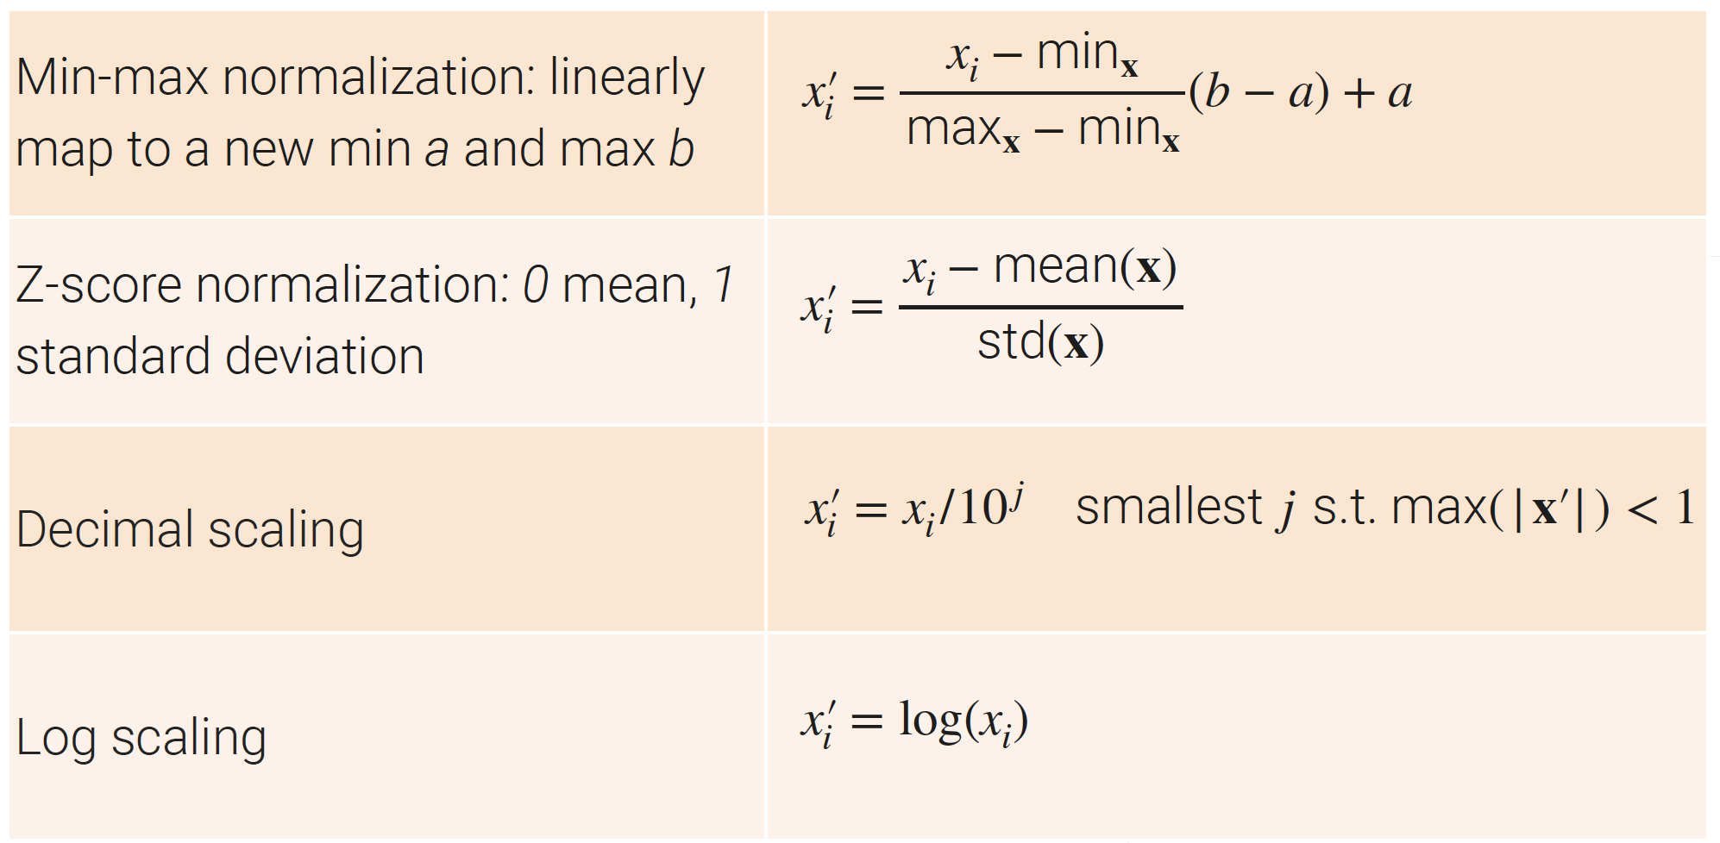
Commonly used normalization methods

Slide 6
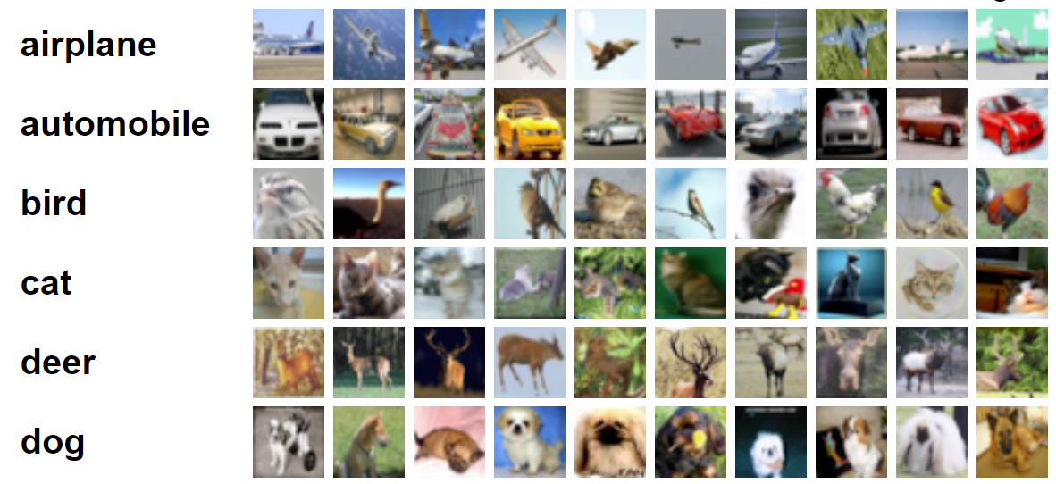
Image transformations
Our previous web scraping will scrape 15 TB images for a year
  5 millions houses sold in US per year, ~20 images/house, ~153KB per image, ~1041x732 resolution
cropping, downsampling, compression
  Save storage cost, faster loading at training
    At ~320x224 resolution, 15 TB -> 1.4TB
  ML is good at low-resolution images
Be aware of lossy compression
    Medium (80%-90%) jpeg compression may lead to 1% acc drop in ImageNet
CIFAR10 dataset
(each image: 32x32 pixels)

Slide 7
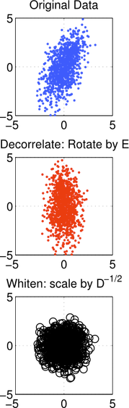
Image transformations
Image whitening
  Generalized normalization of vector values
  Pixels in local neighborhood are highly correlated.
Whitening removes redundancy through linear transformations
  White noise (e.g., TV white noise): zero mean normal distribution, dimensions are uncorrelated.
  Vectors X has mean 0 and covariance estimate
  Y = WX, so that Y has unit diagonal covariance
  Common choices of whitening matrix: Eigen-system of PCA
Model converges faster with whitened image input
  Especially for unsupervised learning, e.g. GAN
PCA Whitening

Slide 8
Video transformations
Input variability high
  Average video length: Movies ~2h, YouTube videos ~11min, Tiktok short videos ~15sec
Tractable ML problems with short video clips (<10sec)
  Ideally each clip is a coherent event (e.g. a human action)
  Semantic segmentation is extremely hard.
Preprocessing to tradeoff storage, quality and loading speed
Common practice: decode a playable video clip, sample a sequence of frames, compute spectrograms for audio
  Easy to load to model, increased storage space

Slide 9
Text transformations – focus of this class
Tokenization
Normalization
Lemmatization
Stemming

Slide 10
Text transformations: Tokenization
Sec. 2.2.1
Input: “Friends, Romans and Countrymen”
Output: Tokens
  Friends
  Romans
  Countrymen
A token is an instance of a sequence of characters
Each such token is now a candidate for further processing

Slide 11
Tokenization
Sec. 2.2.1
Issues in tokenization:
  Finland’s capital → Finland AND s? Finlands? Finland’s? How to handle apostrophes?
  Hewlett-Packard → Hewlett and Packard as two tokens? How to process hyphens?
    state-of-the-art: break up hyphenated sequence.
    co-education
    lowercase, lower-case, lower case ?
    It can be effective to get the user to put in possible hyphens
  San Francisco: one token or two?
    How do you decide it is one token? Phrases may have very different meanings

Slide 12
Tokenization: issues with Numbers
Sec. 2.2.1
3/20/91 Mar. 12, 1991 20/3/91
55 B.C.
B-52
My PGP key is 324a3df234cb23e
(800) 234-2333
  Often have embedded spaces
  Older IR systems may not index numbers
    But often very useful: think about things like looking up error codes/stacktraces on the web
    (One answer is using n-grams: IIR ch. 3)
  Will often index “meta-data” separately
    Creation date, format, etc.

Slide 13
Tokenization: language issues
Sec. 2.2.1
French
  L'ensemble → one token or two?
    L ? L’ ? Le ?
    Want l’ensemble to match with un ensemble
      Until at least 2003, it didn’t on Google
        Internationalization!
German noun compounds are not segmented
  Lebensversicherungsgesellschaftsangestellter
  ‘life insurance company employee’
  German retrieval systems benefit greatly from a compound splitter module
      Can give a 15% performance boost for German

Slide 14
Tokenization: language issues
Sec. 2.2.1
Chinese and Japanese have no spaces between words:
  莎拉波娃现在居住在美国东南部的佛罗里达。
  Not always guaranteed a unique tokenization
Further complicated in Japanese, with multiple alphabets intermingled
  Dates/amounts in multiple formats
  フォーチュン500社は情報不足のため時間あた$500K(約6,000万円)
Katakana
Hiragana
Kanji
Romaji
End-user can express query entirely in hiragana!

Slide 15
Tokenization: language issues
Sec. 2.2.1
Arabic (or Hebrew) is basically written right to left, but with certain items like numbers written left to right
Words are separated, but letter forms within a word form complex ligatures
← → ← → ← start
‘Algeria achieved its independence in 1962 after 132 years of French occupation.’
With Unicode, the surface presentation is complex, but the stored form is straightforward

Slide 16
Stop words
Sec. 2.2.2
With a stop list, you exclude from the dictionary entirely the commonest words. Intuition:
  They have little semantic content: the, a, and, to, be
  There are a lot of them: ~30% of postings for top 30 words
But the trend is away from doing this:
  Good compression techniques to make the cost for including stop words in a system is very small
  Preserving meanings. You need them for:
    Phrase queries: “King of Denmark”
    Various song titles, etc.: “Let it be”, “To be or not to be”
    “Relational” queries: “flights to London”
Notes:
Nevertheless: “Google ignores common words and characters such as where, the, how, and other digits and letters which slow down your search without improving the results.” (Though you can explicitly ask for them to remain.)

Slide 17
Normalization
Sec. 2.2.3
We may need to “normalize” words into the same form
  We want to match U.S.A. and USA
We most commonly implicitly define equivalence classes of terms by, e.g.,
  deleting periods to form a term
    U.S.A., USA
  deleting hyphens to form a term
    anti-discriminatory, antidiscriminatory

Slide 18
Normalization: Case folding
Sec. 2.2.3
Reduce all letters to lower case
  exception: upper case in mid-sentence?
    e.g., General Motors
    Fed vs. fed
    SAIL vs. sail
  Often best to lower case everything, since users will use lowercase regardless of ‘correct’ capitalization…

Slide 19
Ambiguity may be caused by normalization
Famous example
  Google Query: “C.A.T.”
  #1 result is for “cats”, not Caterpillar Inc.

Slide 20
Lemmatization
Sec. 2.2.4
Reduce inflectional/variant forms to base form
E.g.,
  am, are, is → be
  car, cars, car's, cars' → car
the boy's cars are different colors → the boy car be different color
Lemmatization implies doing “proper” reduction to dictionary headword form

Slide 21
Stemming
Sec. 2.2.4
Reduce terms to their “roots”(more aggressive type of lemmatization)
“Stemming” suggests crude affix chopping
  language dependent
  e.g., automate(s), automatic, automation all reduced to automat.
for example compressed
and compression are both
accepted as equivalent to
compress.
for exampl compress and
compress ar both accept
as equival to compress

Slide 22
Stemmer example:
Porter’s algorithm
Sec. 2.2.4
Commonest algorithm for stemming English
  Results suggest it’s at least as good as other stemming options
Conventions + 5 phases of reductions
  phases applied sequentially
  each phase consists of a set of commands
  sample convention: Of the rules in a compound command, select the one that applies to the longest suffix.

Slide 23
Typical rules in Porter
Sec. 2.2.4
sses → ss
ies → i
ational → ate
tional → tion
Weight of word sensitive rules
(m>1) EMENT →
    replacement → replac
    cement → cement
Notes:
careses
parties
separational -> separate
factional -> faction

Slide 24
Other stemmers
Sec. 2.2.4
Other stemmers exist:
  Lovins stemmer
    http://www.comp.lancs.ac.uk/computing/research/stemming/general/lovins.htm
    Single-pass, longest suffix removal (about 250 rules)
  Paice/Husk stemmer
  Snowball

Slide 25
Does stemming help?
Sec. 2.2.4
In search relevance
  English: very mixed results
  Definitely useful for Spanish, German, Finnish,…
Text mining
  Uncertain, needs to be evaluated case by case

Slide 26
Final result: terms and the dictionary
Result is terms: a term is a normalized/lemmatized/stemmed word type, which is an entry in our dictionary
A dictionary is a global structure for a collection of documents

Slide 27
Text transformation: the whole procedure
A document → tokens → stop words removed → normalized words → lemmatized words (small reduction) → stemmed words (aggressive reduction)
May skip some of the later steps (e.g., lemmatization or stemming)
Finally, we get “terms”: all terms from the collection of documents make the “dictionary”

Slide 28
Overall Summary
Transform data into formats preferred by ML algorithms
  Tabular: normalize real value features
  Images: cropping, downsampling, whitening
  Videos: clipping, sampling frames
  Text: tokenization, normalization, lemmatization, stemming
Need to balance storage, quality, and loading speed

